Slide 1
Indoor Segmentation and Support Inference from RGBD Images
Nathan Silberman, Derek Hoiem,
Pushmeet Kohli, Rob Fergus

Slide 2
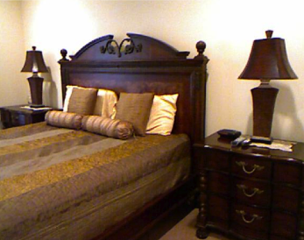
Goal: Infer Support for Every Region
Nightstand Supported by Floor
Lamp Supported by Nightstand
Notes:
The goal of this work is…
Give at least one example (lamp supported by…)

Slide 3
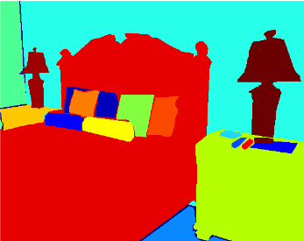
Goal: Infer Support for Every Region
Notes:
Image, Parse it, what other region is supporting it

Slide 4
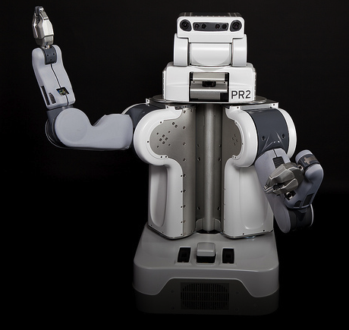

Why infer physical support?
Interacting with objects may have physical consequences!
Notes:
Why is this an interesting problem?
GIVE ONE EXAMPLE

Slide 5
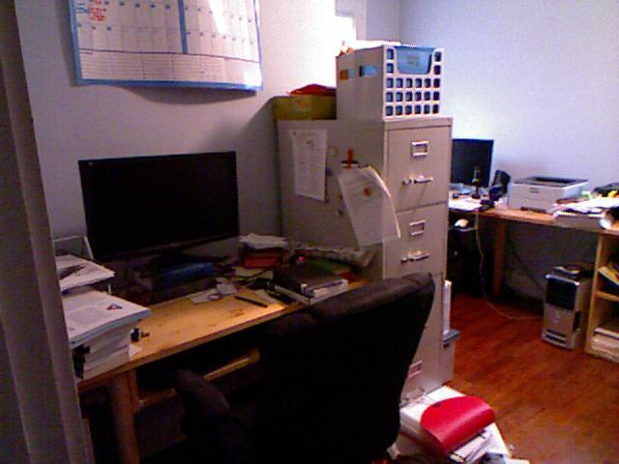
Why infer physical support: Recognition
Object on top of desk
Object hanging from file cabinet

Slide 6
Why infer physical support: Recognition

Slide 7
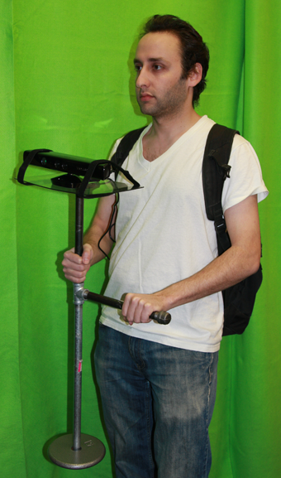

Working with RGB+Depth
Captured with Microsoft Kinect
Restricted to Indoor Scenes
Notes:
I should point out that …
- Depth makes the problem easier
Access to scene geometry
- We can concentrate on representation

Slide 8
NYU Depth Dataset Version 2.0
Collected new NYU Depth Dataset
Much larger than NYU Depth 1.0
  464 Scenes
  1449 Densely Labeled frames
  Over 400,000 Unlabeled frames
  Over 800 Semantic Classes
  Full videos available
Larger variation in scenes
Dense Labels much higher quality
http://cs.nyu.edu/~silberman/datasets/nyu_depth_v2.html

Slide 9
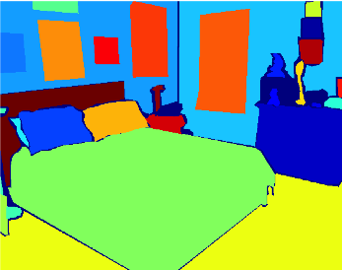
High Quality Semantic Labels
Wall 1
Wall
Picture 1
Picture 2
Picture 3
Window
Doll 1
Headboard
Lamp
Doll 2
Pillow 1
Pillow 2
Nightstand
Dresser
Pillow 3
Bed
Floor
Notes:
All of the images have dense, high quality object AND instance labels

Slide 10
High Quality Support Labels
Support from below
Support from behind
Support from hidden region

Slide 11
RGBD Image
Segmentation
Support Inference
Notes:
What we want is to go from RGBD to a set of regions, a segmentation from which we can predict support relations

Slide 12
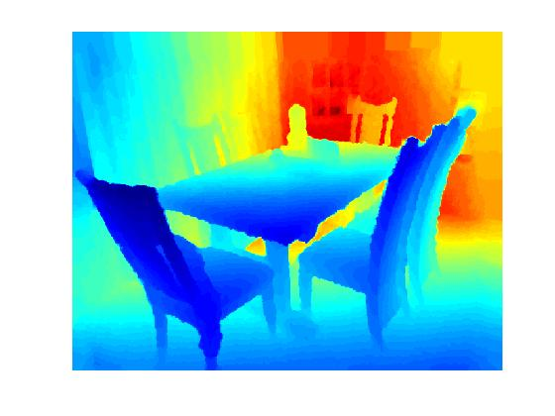
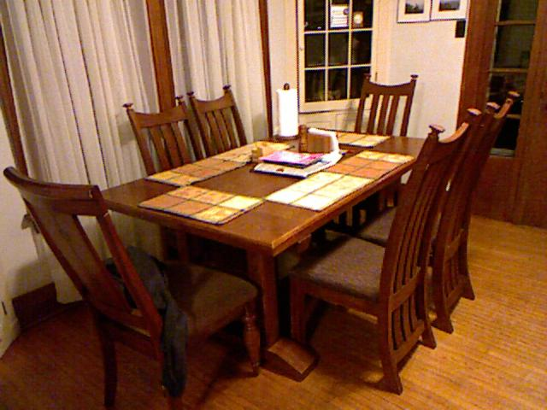
Scene Parsing
Input
Notes:
What we want is to go from RGBD to a set of regions, a segmentation from which we can predict support relations

Slide 13
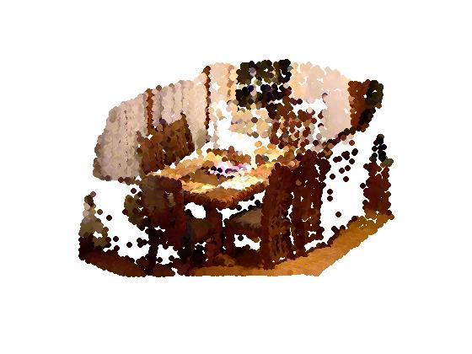
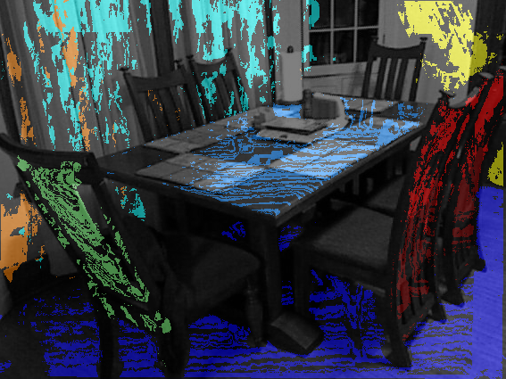
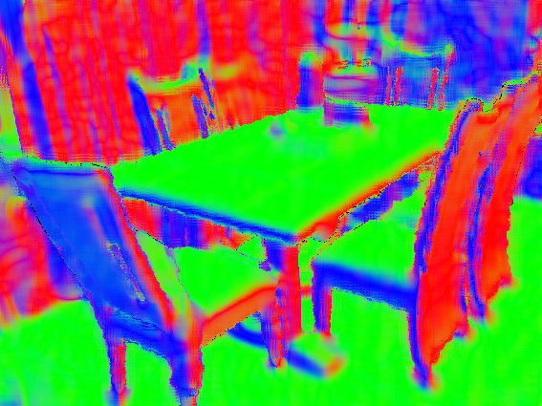
Scene Parsing
Input
Major Surfaces
Surface Normals
Aligned Point Cloud
Notes:
Fit surface normals, find major surfaces

Slide 14
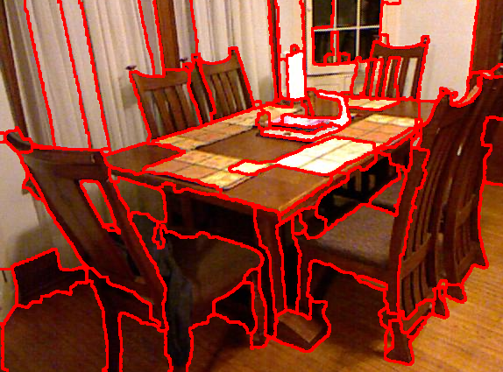
Scene Parsing
Input
Major Surfaces
Surface Normals
Aligned Point Cloud
Segmentation
Notes:
Then we want to segment the image into regions so that we can infer the support of the resulting regions.

Slide 15
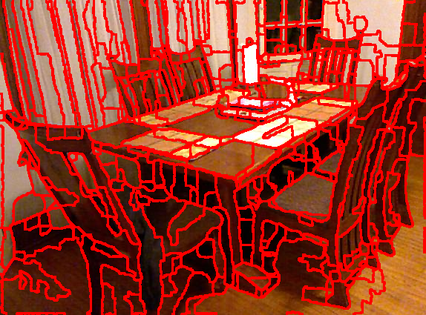
Hierarchical Segmentation
Segmentation Scheme similar to: Recovering Occlusion Boundaries from a Single Image D. Hoiem, A.N. Stein, A.A. Efros, and M. Hebert, ICCV 2007.
Notes:
Hierarchical Agglomerative Segmentation

Slide 16
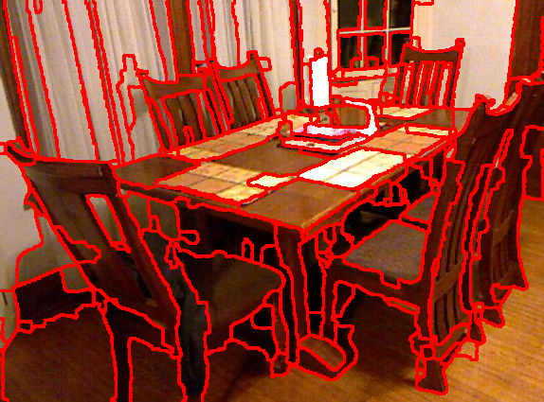
Hierarchical Segmentation
Segmentation Scheme similar to: Recovering Occlusion Boundaries from a Single Image D. Hoiem, A.N. Stein, A.A. Efros, and M. Hebert, ICCV 2007.

Slide 17
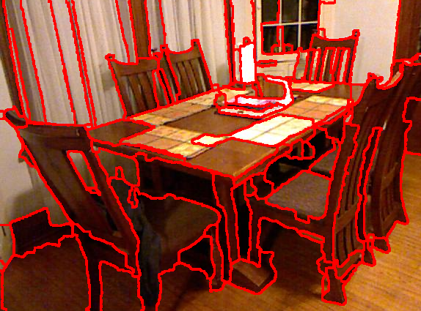
Hierarchical Segmentation
Segmentation Scheme similar to: Recovering Occlusion Boundaries from a Single Image D. Hoiem, A.N. Stein, A.A. Efros, and M. Hebert, ICCV 2007.

Slide 18

Hierarchical Segmentation
Segmentation Scheme similar to: Recovering Occlusion Boundaries from a Single Image D. Hoiem, A.N. Stein, A.A. Efros, and M. Hebert, ICCV 2007.

Slide 19
Hierarchical Segmentation
Segmentation Scheme similar to: Recovering Occlusion Boundaries from a Single Image D. Hoiem, A.N. Stein, A.A. Efros, and M. Hebert, ICCV 2007.

Slide 20
Scene Parsing
Input
Major Surfaces
Surface Normals
Aligned Point Cloud
Segmentation
Notes:
Then we want to segment the image into regions so that we can infer the support of the resulting regions.

Slide 21
Scene Parsing
Input
Major Surfaces
Surface Normals
Aligned Point Cloud
Segmentation
Support Inference
Notes:
Then we want to segment the image into regions so that we can infer the support of the resulting regions.

Slide 22
RGBD Image
Segmentation
Support Inference

Slide 23
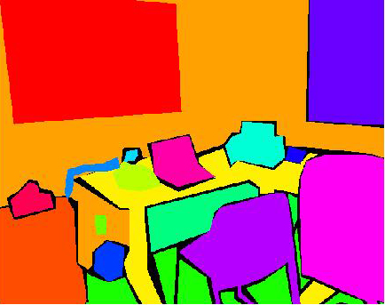
Modeling Choice #1
All objects supported by a single object except –
Floor requires no support.
2
2. Picture
3
3. Wall
1. Chair
1
4. Floor
4
Image Regions
(Inverted) Tree Representation
Notes:
Some notes on our model
BRIEF PAUSE

Slide 24
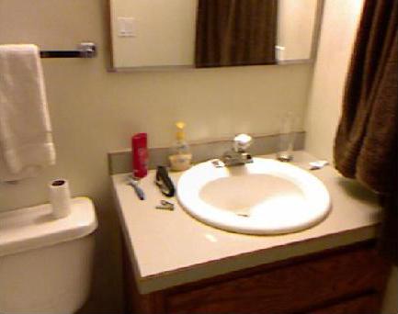
Modeling Choice #2
All objects are either supported by another region in the image OR a hidden region.

Slide 25
Modeling Choice #2
All objects are either supported by another region in the image OR a hidden region.
Deoderant supported by counter

Slide 26
Modeling Choice #2
All objects are either supported by another region in the image OR a hidden region.
Cabinet supported by hidden region

Slide 27
Modeling Choice #3
Every object is either supported from below or from behind.

Slide 28
Modeling Choice #3
Every object is either supported from below or from behind.
Deoderant supported from below

Slide 29
Modeling Choice #3
Every object is either supported from below or from behind.
Mirror supported from behind

Slide 30
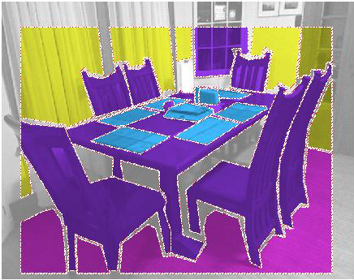
Modeling Support: Structure Classes
‘Structure Classes’ encode high level support prior knowledge
(1) Ground (2) Furniture (3) Prop or (4) Structure
Notes:
Solving the full recognition problem is too hard, having this high level classes allows us to inject prior knowledge into support inference.

Slide 31

Modeling Support
Goal: For each region in regions, infer:
Supporting region
Support Type
Structure class

Slide 32

Modeling Support
Goal: For each region in regions, infer:
Supporting region
Support Type
Structure class
The formal problem per image:

Slide 33
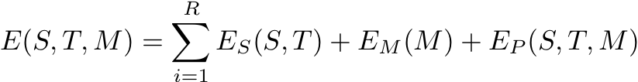



Joint Energy Factorizes into three terms:
Local Support
Local Structure Class
Prior
- supporting region
- support type
- structure class

Slide 34
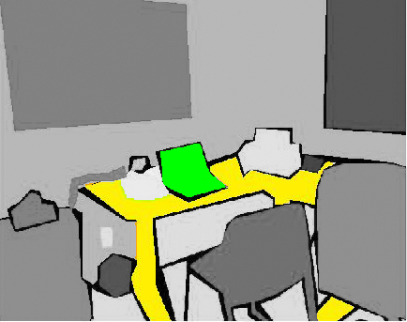

Local Support Energy
- supporting region
- support type
- structure class
1
comes from logistic regressor trained on pairwise features
2

Slide 35
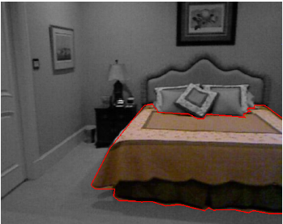

Local Structure Class Energy
- supporting region
- support type
- structure class
from logistic regressor trained on features from each individual region

Slide 36
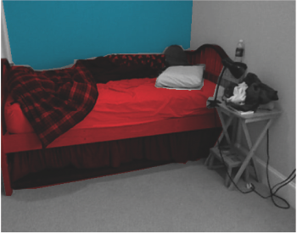
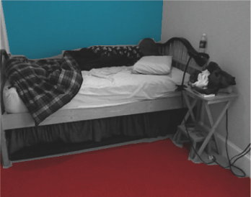

Prior (1/4): Transitions
- supporting region
- support type
- structure class
A region’s structure class helps predict its support.
Structure
Structure
OR
Furniture
Floor

Slide 37
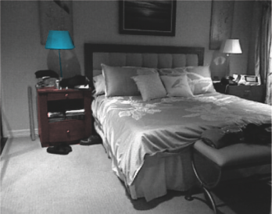
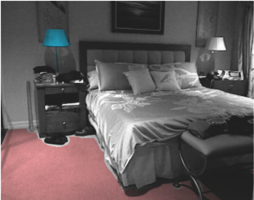
Prior (2/4): Support Consistency
- supporting region
- support type
- structure class
Supporting regions should be nearby
OR
Notes:
Vert dist vs horz dist

Slide 38
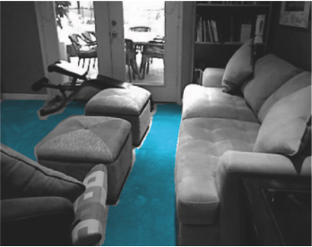
Prior (3/4): Ground Consistency
- supporting region
- support type
- structure class
A region requires no support if and only if its structure class is ‘floor’

Slide 39
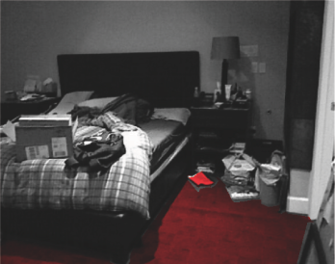

Prior (4/4): Global Ground Consistency
- supporting region
- support type
- structure class
A region is unlikely to be the floor if another floor region is lower than it
OR
Floor
Prop
Floor
Floor

Slide 40






Integer Program Formulation
Relaxed to Linear Program
Notes:
We relax the problem and solve it as a Linear Program (Gurobi LP Solver)
For 99% of images, LP solution is within 1% of the global optimum

Slide 41
Experiments

Slide 42
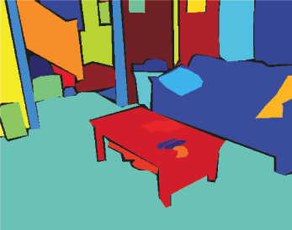
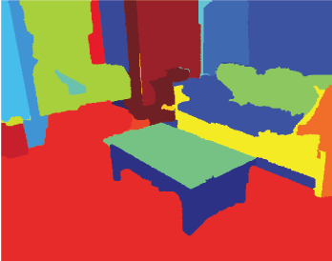
Evaluating Support
Accuracy =
# of Correctly Labeled Support Relationships
# of Total Labeled Support Relationships
Evaluation with features extracted from:
Regions from Ground Truth Labels
Regions from Segmentation

Slide 43
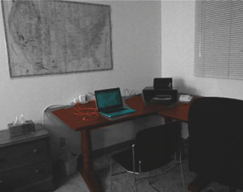
Baseline #1: Image Plane Rules
Heuristic: look at neighboring regions for support

Slide 44
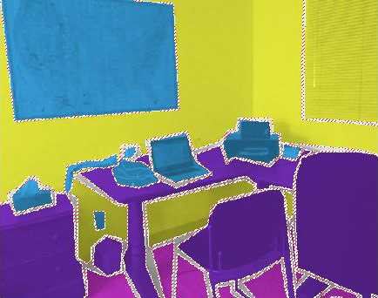
Baselines #2: Structure Class Rules
Heuristic: Support is deterministic given Structure Classes
Structure
Prop
Furniture
Floor

Slide 45
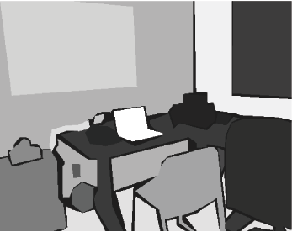
Baselines #3: Support Classifier
Use only the output of support classifier

Slide 46
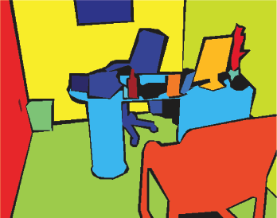
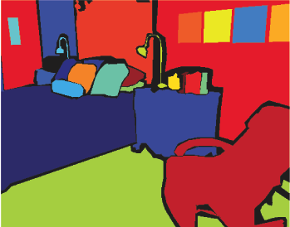
Evaluating Support
(Regions from Ground Truth Labels)
Examples of Manually Labeled Regions
Notes:
Make clear that this is when we use ground truth regions first, remind ppl what support type means

Slide 47
Evaluating Support
(Regions from Ground Truth Labels)
Examples of Manually Labeled Regions
Notes:
Make clear that this is when we use ground truth regions first, remind ppl what support type means

Slide 48
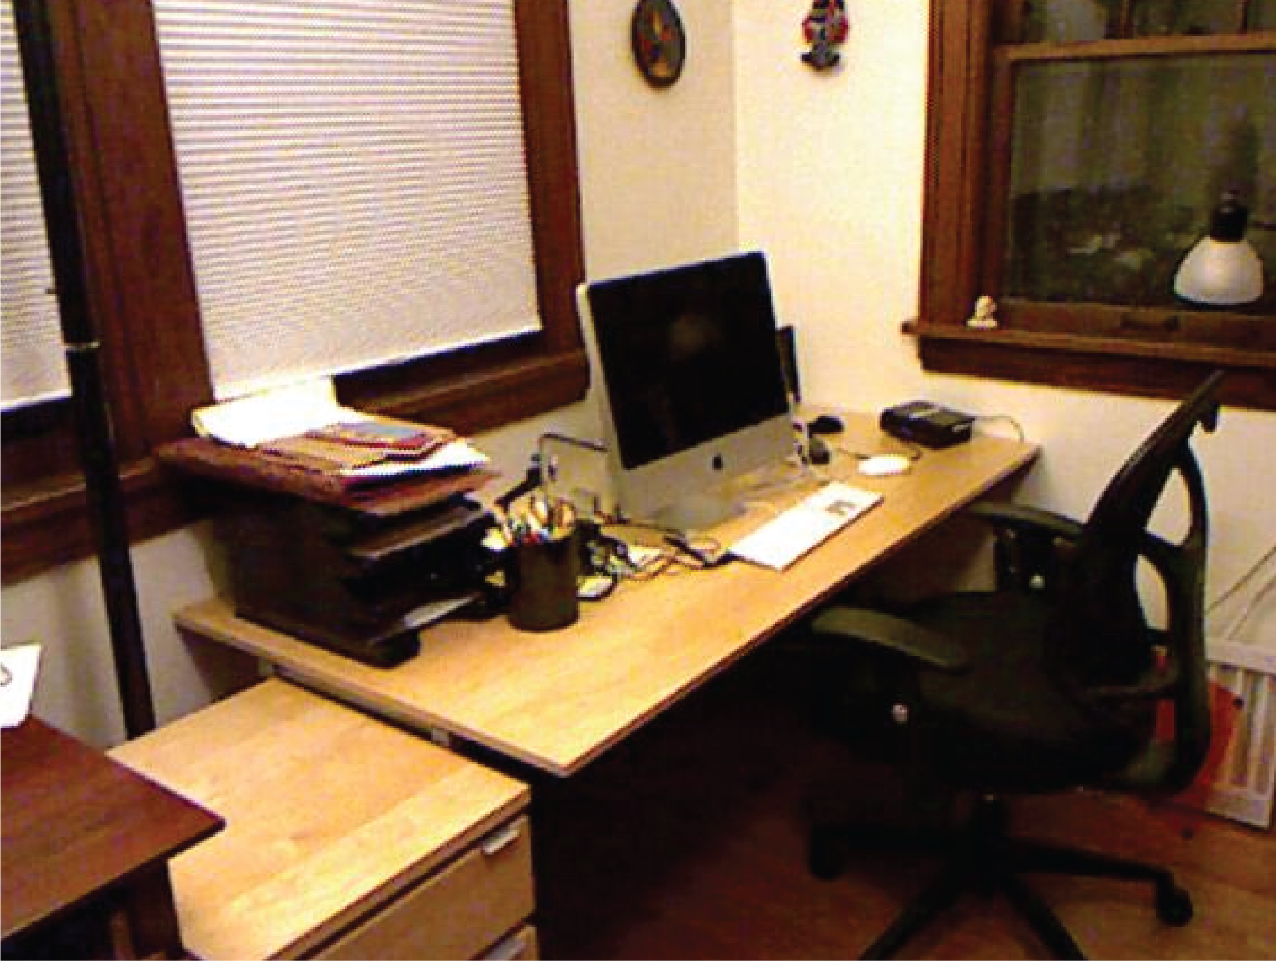
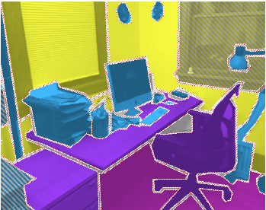
Results
Ground Truth Regions
Floor
Prop
Furniture
Structure
Notes:
TALK THROUGH THE SLIDE!!!
BE POSITIVE

Slide 49
Results
Ground Truth Regions
Correct Prediction
Notes:
TALK THROUGH THE SLIDE!!!
BE POSITIVE

Slide 50
Results
Ground Truth Regions
Correct Prediction
Incorrect Prediction
Notes:
TALK THROUGH THE SLIDE!!!
BE POSITIVE

Slide 51
Results
Ground Truth Regions
Correct Prediction
Support from below
Incorrect Prediction
Notes:
TALK THROUGH THE SLIDE!!!
BE POSITIVE

Slide 52
Results
Ground Truth Regions
Correct Prediction
Support from below
Support from behind
Incorrect Prediction
Notes:
TALK THROUGH THE SLIDE!!!
BE POSITIVE

Slide 53
Results
Ground Truth Regions
Correct Prediction
Support from below
Support from behind
Incorrect Prediction
Support from hidden region
Notes:
TALK THROUGH THE SLIDE!!!
BE POSITIVE

Slide 54
Results
Ground Truth Regions
Correct Prediction
Support from below
Support from behind
Incorrect Prediction
Support from hidden region
Notes:
TALK THROUGH THE SLIDE!!!
BE POSITIVE

Slide 55
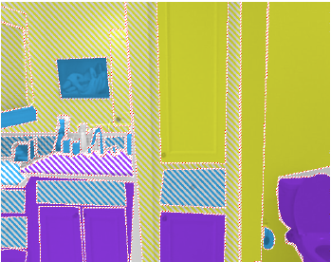
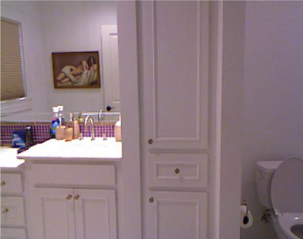
Results
Ground Truth Regions
Correct Prediction
Support from below
Support from behind
Incorrect Prediction
Support from hidden region
Notes:
TALK THROUGH THE SLIDE!!!
BE POSITIVE

Slide 56


Evaluating Support
(Regions from Segmentation)
Examples of Regions from Segmentation
Notes:
Make clear that this is when we use ground truth regions first, remind ppl what support type means

Slide 57
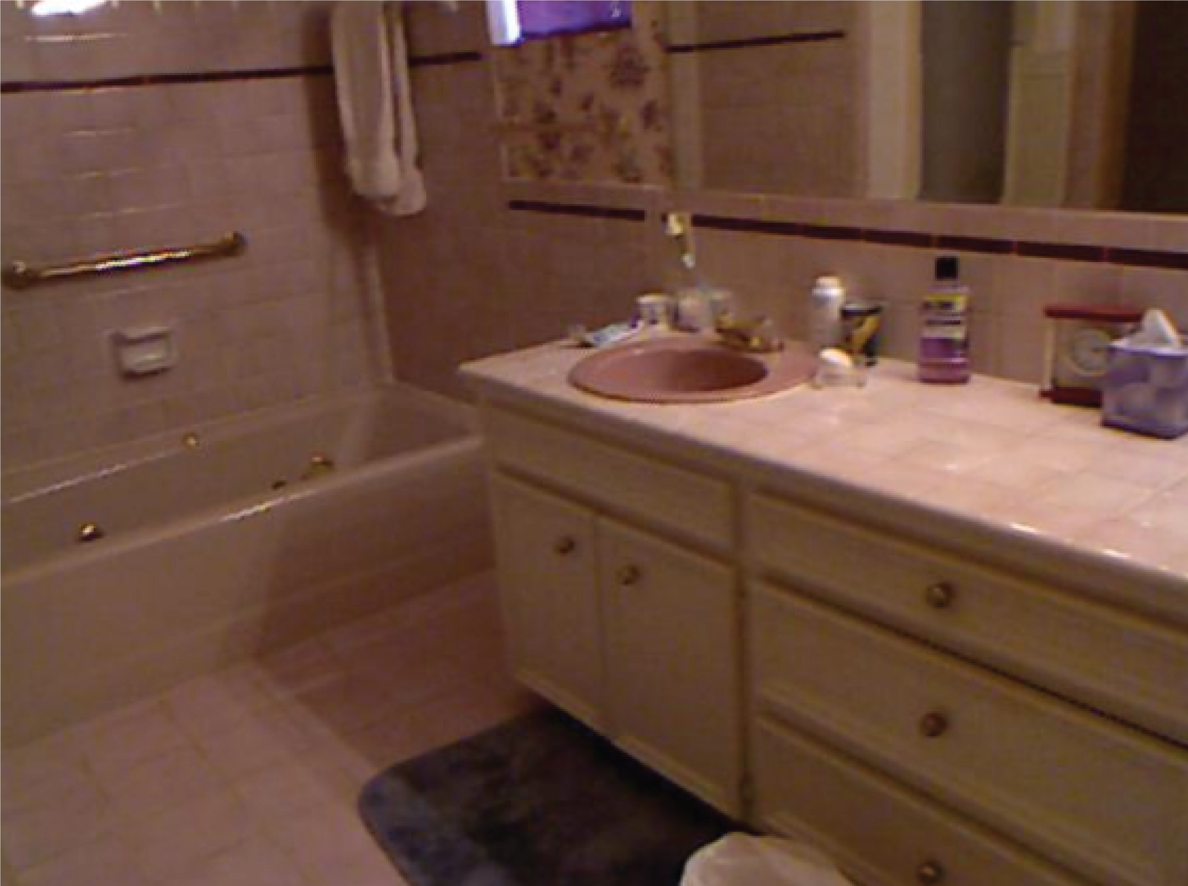
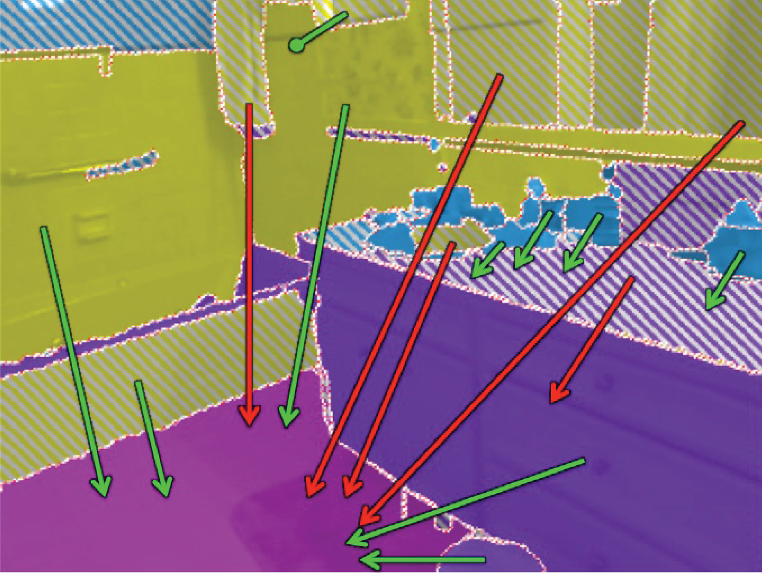
Results
Automatically Segmented Regions
Correct Prediction
Support from below
Support from behind
Incorrect Prediction
Support from hidden region
Notes:
Mistakes
Structure class error (towel)
- rug as floor error

Slide 58
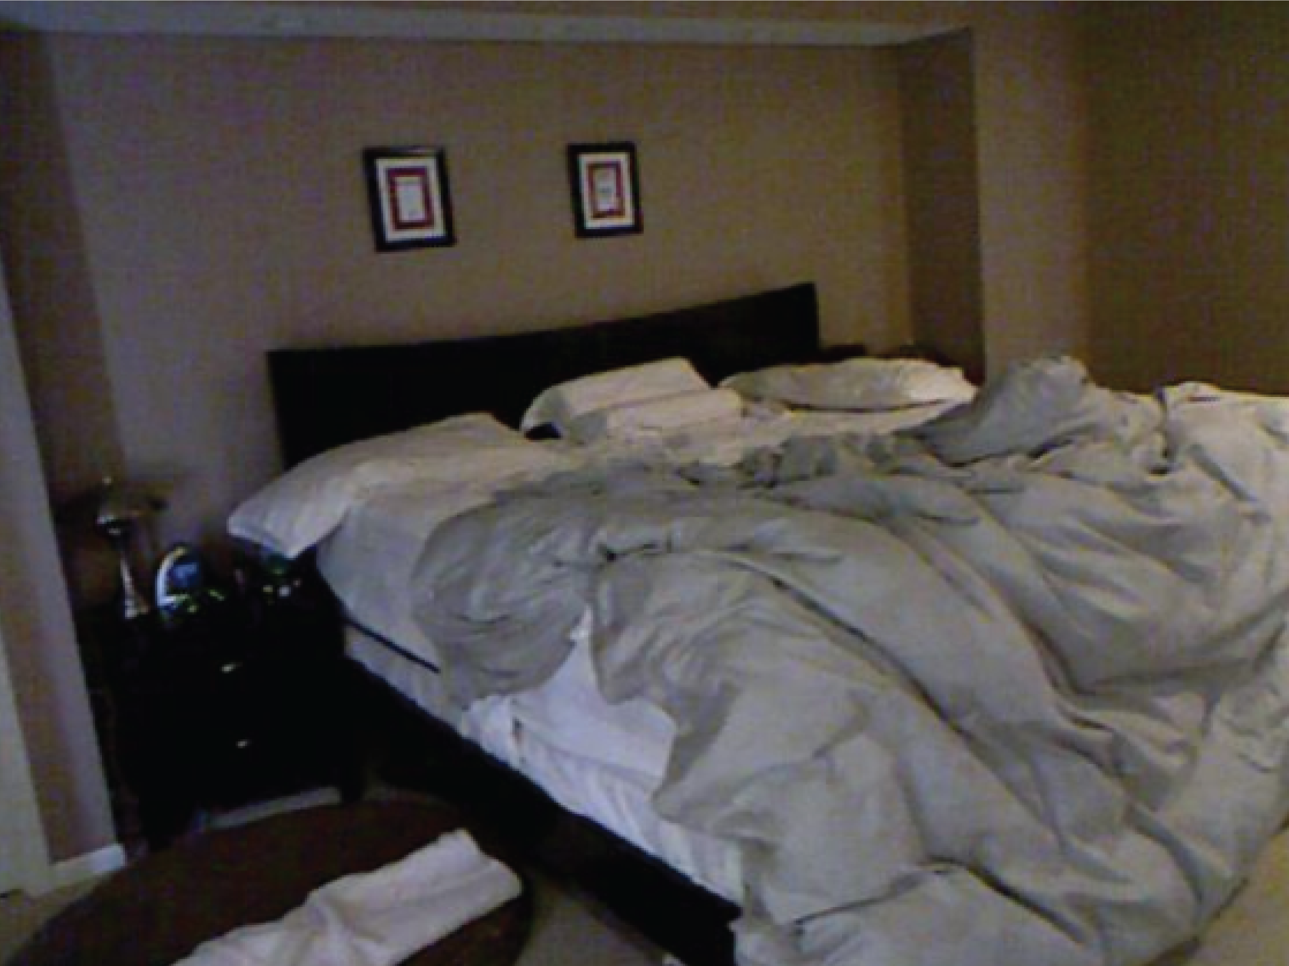
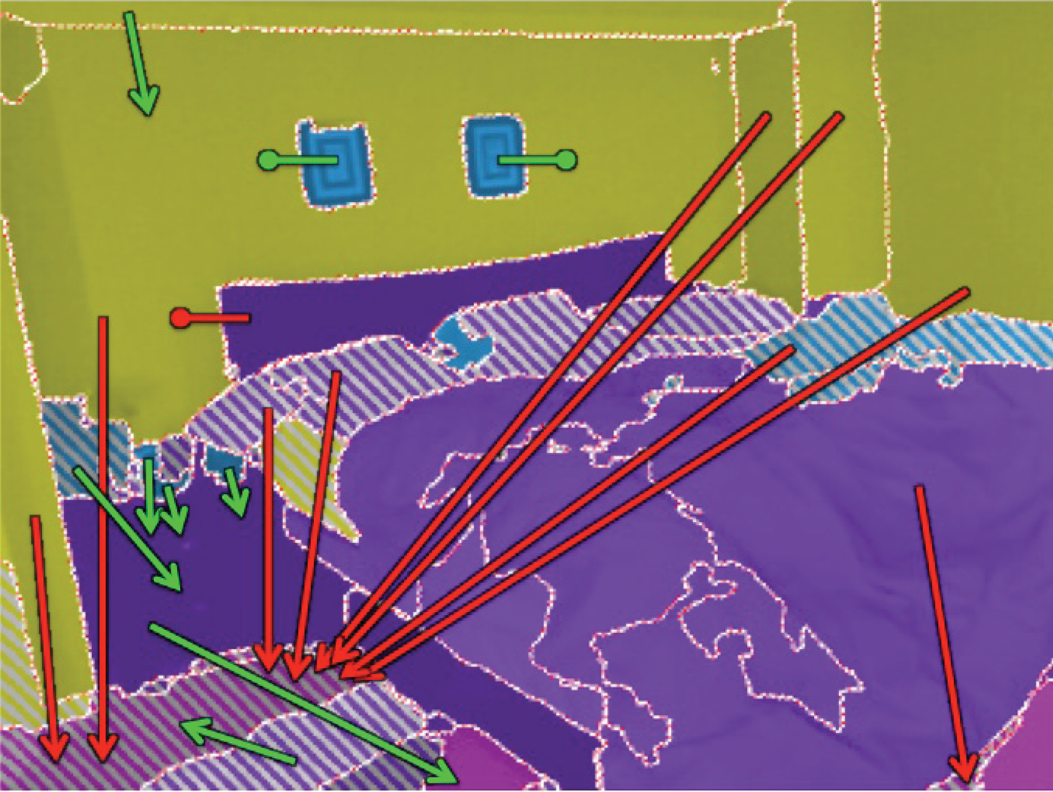
Results
Automatically Segmented Regions
Correct Prediction
Support from below
Support from behind
Incorrect Prediction
Support from hidden region

Slide 59
Conclusion
Algorithm for inferring Physical Support
Novel Integer Program Formulation
3D Cues for segmentation
Dataset:
  http://cs.nyu.edu/~silberman/datasets/nyu_depth_v2.html
Code:
  http://cs.nyu.edu/~silberman/projects/indoor_scene_seg_sup.html

