Slide 1
Diagnosing Error in Object Detectors
Derek Hoiem
Yodsawalai Chodpathumwan
Qieyun Dai
Department of Computer Science
University of Illinois at Urbana-Champaign (UIUC)
Work supported in part by NSF awards IIS-1053768 and IIS-0904209, ONR MURI Grant N000141010934, and a research award from Google

Slide 2
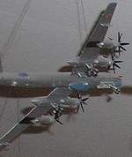
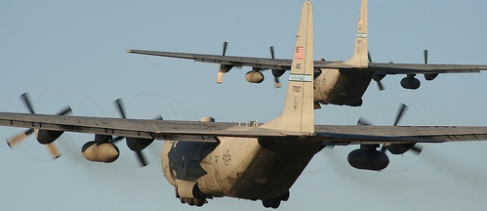
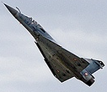
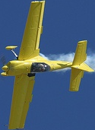
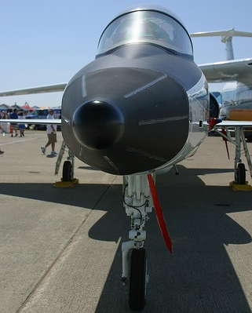
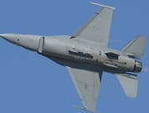
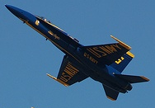
Object detection is a collection of problems
Intra-class Variation for “Airplane”
Occlusion
Shape
Viewpoint
Distance
Notes:
Object category detection is really a collection of problems. You have to organize instances and learn sets of appearance models that are robust to occlusion and encode variations due to viewpoint, distance, and different object examples.
Object detection is a complex problem. Categories are hetergeneous: examples from the same category may look quite different from each other. Variations are due to different object examples, viewpoint, distance, and occlusion. At the same time, non-objects may fit the object appearance model due to random background textures, semantically similar objects, dissimilar objects
, involving differ a collection of objects with varying viewpoint, distance, and degrees of occlusion

Slide 3
Object detection is a collection of problems
Confusing Distractors for “Airplane”
Similar Categories
Dissimilar Categories
Localization Error
Background
Notes:
Varied examples of the object category must be differentiated from various distractors: random background textures, semantically similar objects, dissimilar objects, or misaligned examples.

Slide 4
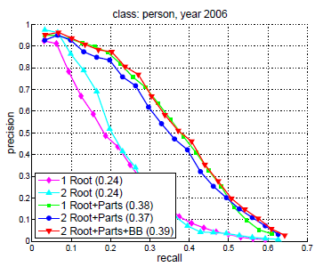
How to evaluate object detectors?
Average Precision (AP)
Good summary statistic for quick comparison
Not a good driver of research
We propose tools to evaluate
where detectors fail
potential impact of particular improvements
Typical evaluation through comparison of AP numbers
figs from Felzenszwalb et al. 2010
Notes:
For such a complex task, we need a suite of analysis tools to evaluate performance and proscribe areas most in need of improvement. For several years, average precision has been the standard and typically exclusive metric for evaluation. AP is good as a single measure to compare detectors, but it’s not a good driver of research. It doesn’t tell us why one method outperforms or how it could best be improved. We propose tools to evaluate where detectors fail and the potential impact of different kinds of improvements.

Slide 5
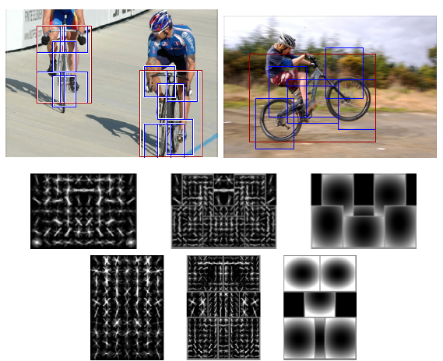
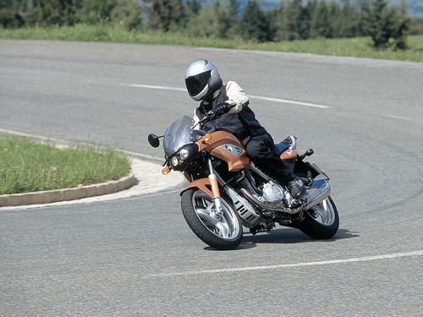
Detectors Analyzed as Examples on VOC 2007
Deformable Parts Model (DPM)
Multiple Kernel Learning (MKL)
Sliding window
Mixture of HOG templates with latent HOG parts
Jumping window
Various spatial pyramid bag of words features combined with MKL
x
x
x
Felzenszwalb et al. 2010 (v4)
Vedaldi et al. 2009

Slide 6
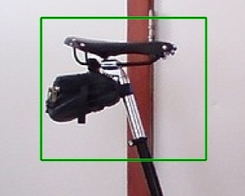
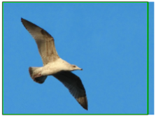
Top false positives: Airplane (DPM)
AP = 0.36
1
5
3
4
27
37
Background
27%
Localization
29%
Other Objects
11%
Similar Objects
33%
Bird, Boat, Car
30
6
2
33
Impact of Removing/Fixing FPs
7
Notes:
Animate.

Slide 7
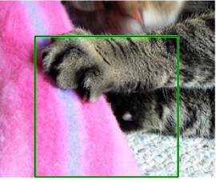
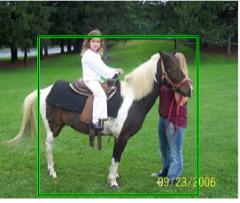
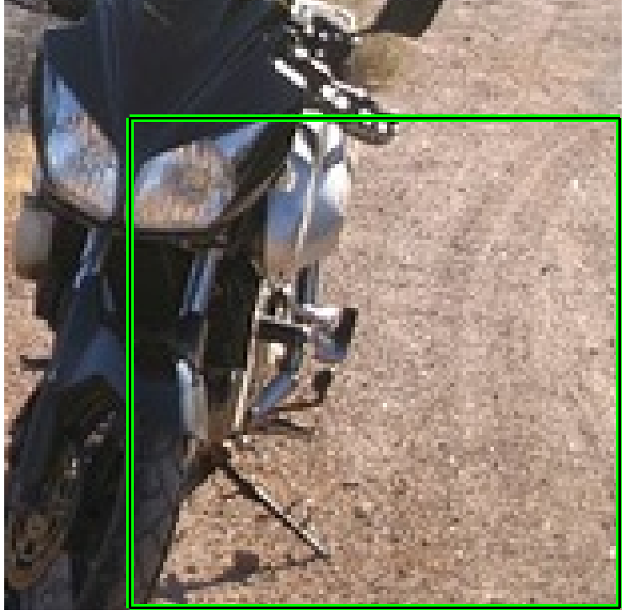
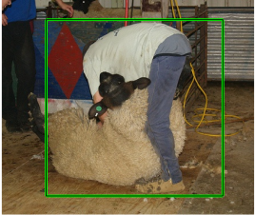
Top false positives: Dog (DPM)
AP = 0.03
1
6
16
Localization
17%
2
4
5
Background
23%
Other Objects
10%
Similar Objects
50%
Person, Cat, Horse
8
3
9
22
Impact of Removing/Fixing FPs
10

Slide 8
Top false positives: Dog (MKL)
Background
4%
AP = 0.17
Other Objects
5%
Localization
17%
Impact of Removing/Fixing FPs
Similar Objects
74%
Cow, Person, Sheep, Horse
Top 5 FP
Notes:
Most promising directions for improvement vary by detector and can be discovered with analysis

Slide 9
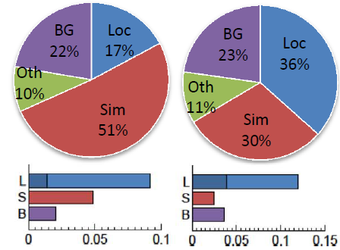
Summary of False Positive Analysis
DPM v4
(FGMR 2010)
MKL
(Vedaldi et al. 2009)
Notes:
Both: biggest improvement through localization error. For animals and vehicles, small improvement by removing false positives due to background and dissimilar objects. The MKL detector makes more reasonable mistakes on animals than the DPM detector.

Slide 10
Analysis of object characteristics
Additional annotations for seven categories: occlusion level, parts visible, sides visible
Occlusion Level

Slide 11
Normalized Average Precision
Average precision is sensitive to number of positive examples
Normalized average precision: replace variable N_{j} with fixed N
$$Precision= \frac{TruePositives}{TruePositives+FalsePositives}$$
$$TruePositives=Recall∗N_{j}$$
Number of object examples in subset j
Notes:
Precision as TP / (TP + FP)

Slide 12
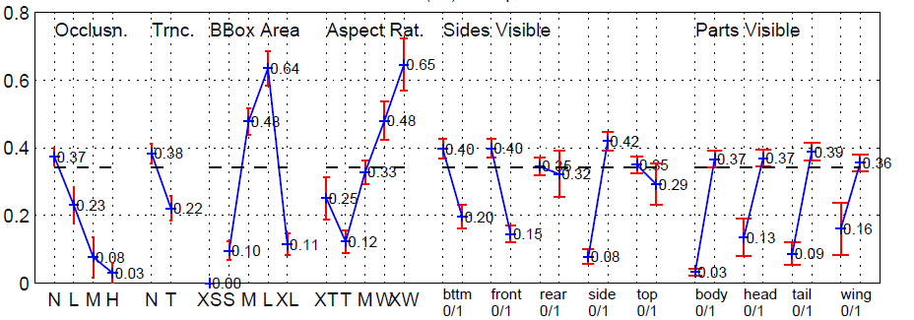
Object characteristics: Aeroplane
Notes:
Put a box

Slide 13
Object characteristics: Aeroplane
Occlusion: poor robustness to occlusion, but little impact on overall performance
Easier (None)
Harder (Heavy)
Notes:
Put a box

Slide 14
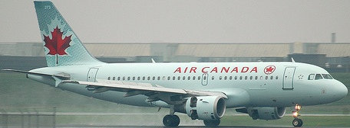
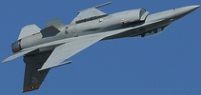
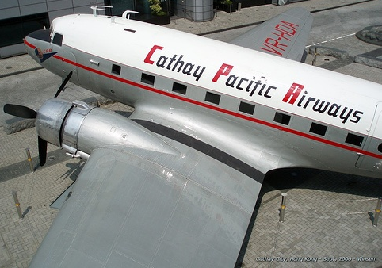
Object characteristics: Aeroplane
Size: strong preference for average to above average sized airplanes
Large
Medium
X-Large
Small
X-Small
Easier
Harder

Slide 15
Object characteristics: Aeroplane
Aspect Ratio: 2-3x better at detecting wide (side) views than tall views
X-Wide
Wide
Medium
X-Tall
Tall
Easier (Wide)
Harder (Tall)

Slide 16
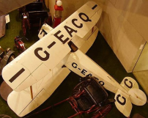
Object characteristics: Aeroplane
Sides/Parts: best performance = direct side view with all parts visible
Easier (Side)
Harder (Non-Side)

Slide 17
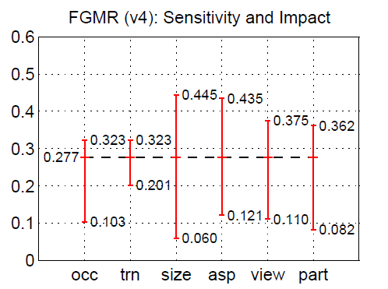
Summarizing Detector Performance
DPM (v4): Sensitivity and Impact
Avg. Performance of Best Case
Avg. Overall Performance
Avg. Performance of Worst Case
Notes:
Animation clarify talking points

Slide 18
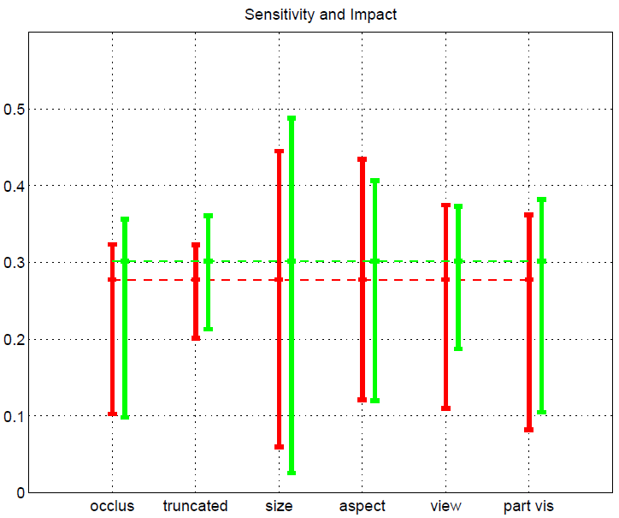
Summarizing Detector Performance
Best, Average, Worst Case
DPM (FGMR 2010)
MKL (Vedaldi et al. 2009)
Impact
Sensitivity
occlusion
trunc
size
aspect
view
part_vis
Notes:
Remarkably similar overall

Slide 19
Summarizing Detector Performance
Best, Average, Worst Case
DPM (FGMR 2010)
MKL (Vedaldi et al. 2009)
Occlusion: high sensitivity, low potential impact
occlusion
trunc
size
aspect
view
part_vis
Notes:
Fel has greater sensitivity to viewpoint; Ved has greater sensitivity to size

Slide 20
Summarizing Detector Performance
Best, Average, Worst Case
DPM (FGMR 2010)
MKL (Vedaldi et al. 2009)
MKL more sensitive to size
occlusion
trunc
size
aspect
view
part_vis
Notes:
Fel has greater sensitivity to viewpoint; Ved has greater sensitivity to size

Slide 21
Summarizing Detector Performance
Best, Average, Worst Case
DPM (FGMR 2010)
MKL (Vedaldi et al. 2009)
DPM more sensitive to aspect
occlusion
trunc
size
aspect
view
part_vis
Notes:
Fel has greater sensitivity to viewpoint; Ved has greater sensitivity to size

Slide 22
Conclusions
Most errors that detectors make are reasonable
Localization error and confusion with similar objects
Misdetection of occluded or small objects
Large improvements in specific areas (e.g., remove all background FPs or robustness to occlusion) has small impact in overall AP
More specific analysis should be standard
Our code and annotations are available online
Automatic generation of analysis summary from standard annotations
www.cs.illinois.edu/homes/dhoiem/publications/detectionAnalysis_eccv12.tar.gz
Notes:
url

Slide 23
Thank you!
Background
4%
AP = 0.17
Other Objects
5%
Top Dog False Positives
Localization
17%
Impact of Removing/Fixing FPs
Similar Objects
74%
Cow, Person, Sheep, Horse
Top 5 FP
www.cs.illinois.edu/homes/dhoiem/publications/detectionAnalysis_eccv12.tar.gz

