Slide 1
- Recovering Human Body Configurations: Combining Segmentation and Recognition (CVPR’04) Greg Mori, Xiaofeng Ren, Alexei A. Efros and Jitendra Malik - Pose primitive based human action recognition in videos or still images (CVPR’08) Christian Thurau and Vaclav Hlavac

Slide 2
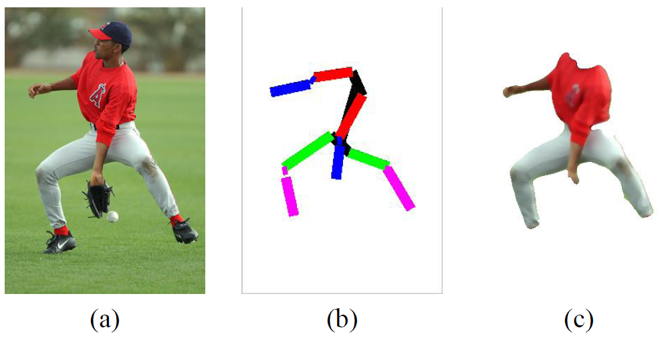
Why pose estimation?
Fully explain human figure detection
Better action representation (?)
Arms, legs are important to distinguish actions

Slide 3
- Recovering Human Body Configurations: Combining Segmentation and Recognition
Greg Mori, Xiaofeng Ren, Alexei A. Efros and Jitendra Malik (Partial slides are from Mori’s)

Slide 4
Problem: Pose recovery
Input image
Extracted skeleton of limbs and joints
Segmentation mask associated with human figure

Slide 5
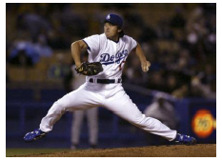
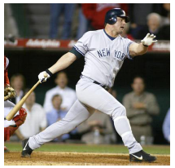
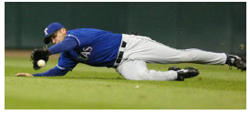
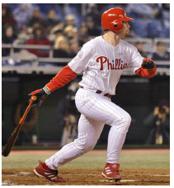
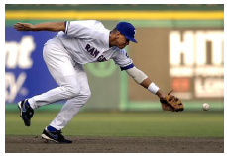
Challenges
Pose variations
Background clutter
Missing parts
Etc.

Slide 6
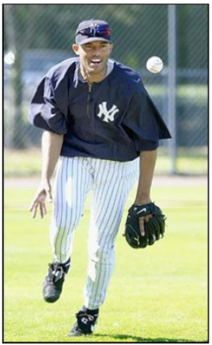
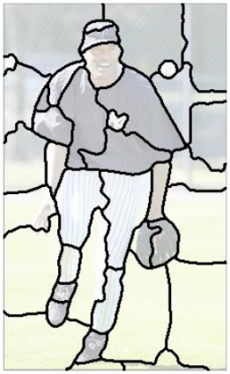
Approach
Bottom up search: find part evidences (half-limbs, torso, head)
Top-down search: joint up parts by using global constraints

Slide 7
Flow of the algorithm
Detecting candidates of half-limbs (a single segment) and torso, head (multiple segments)
Assembling parts to complete the human figure

Slide 8
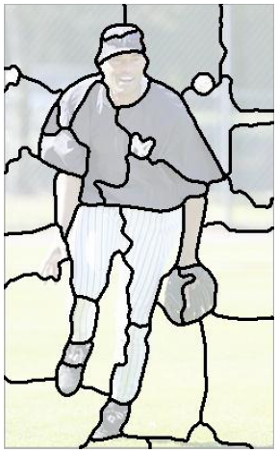
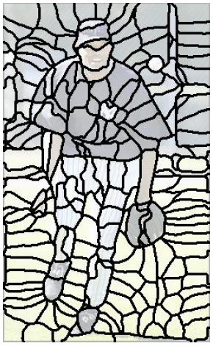
Segmentation helps?
Input image
Half-limbs pop out as single segments
Super-pixels

Slide 9
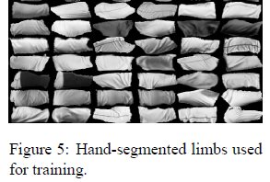
Detecting half-limb candidates
Cues for scoring
Contour (Pb)
Shape (rectangular shape)
Shading (sense of 3D, e.g thigh)
Focus : ratio between high to low frequency energies (background sometimes is out of focus)
Learn a classifier to score segments to be half-limbs and keep top K candidates.

Slide 10
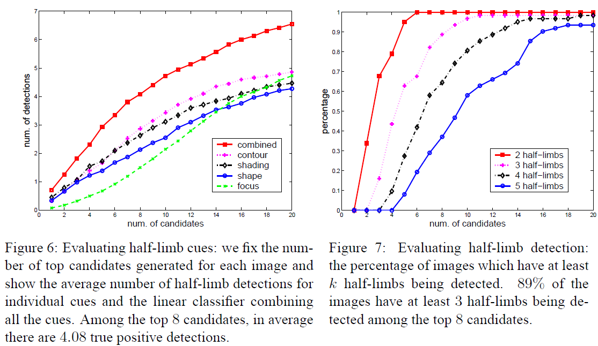
Half-limb detector evaluation

Slide 11
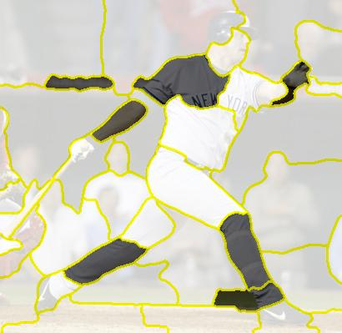
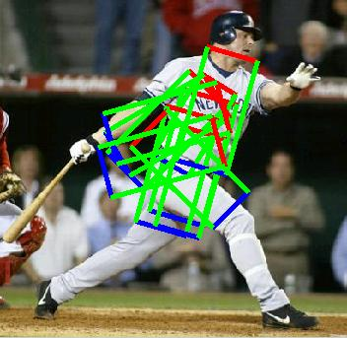
Detecting torso candidates
Same cues except shading
Torso is composed of multiple segments
Also, detect head and joint up with torso, then keep top ranked candidates

Slide 12
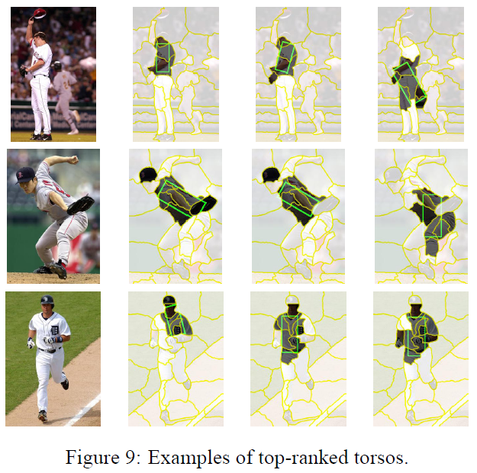
Examples of detected torsos

Slide 13
Pruning Partial Configurations
Many partial configurations are physically impossible
Prune using global constraints
Relative widths of limbs
Lengths of torso
Adjacency
Symmetry in clothing color
Reduce from to 1000 partial configurations

Slide 14
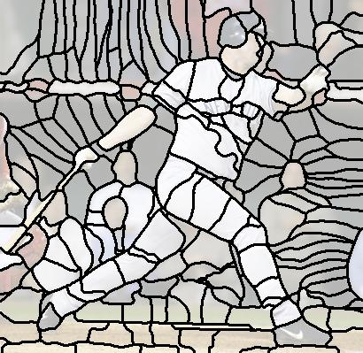
Completing Configurations
Use superpixels to complete half-limbs
Score partial configurations
Use limb, torso, and segmentation scores
Search for missing limb(s)

Slide 15
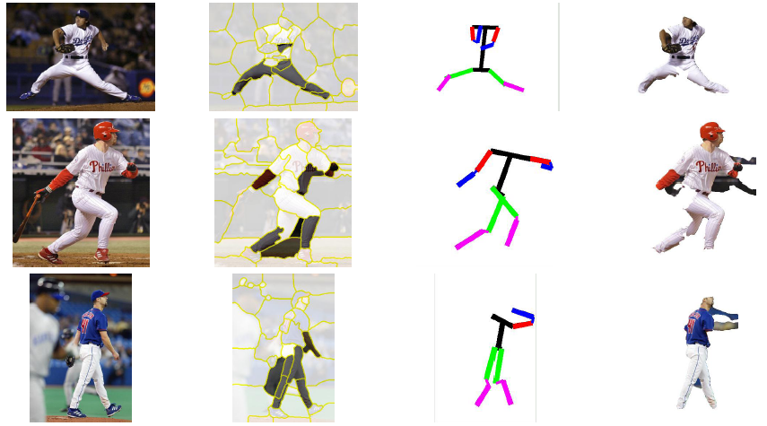
Results 1
1st
18th
1st

Slide 16
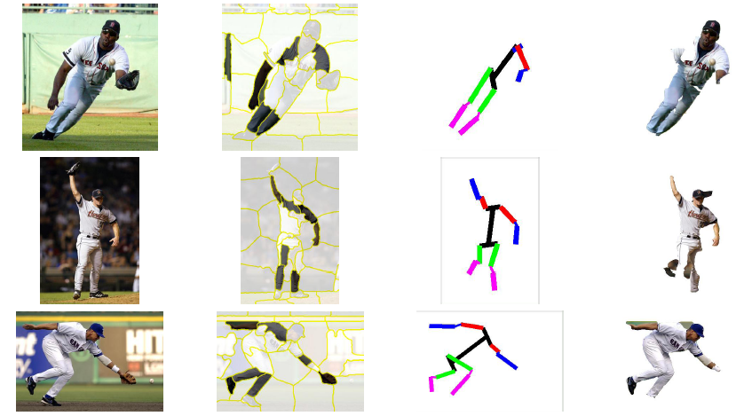
Result 2
3rd
3rd
1st

Slide 17
Comments
Pros: Propose a simple but fairly good of searching strategy for arbitrary poses
Cons:
Depends on the goodness of segmentations (not feasible for ‘wild’ images)
The global search and filling missing limbs is a bit hacky
Questions:
Better limb/torso/head detectors help?
Can improve spatial constraint model?

Slide 18
Pose primitive based human action recognition in videos or still images
Christian Thurau and Vaclav Hlavac

Slide 19
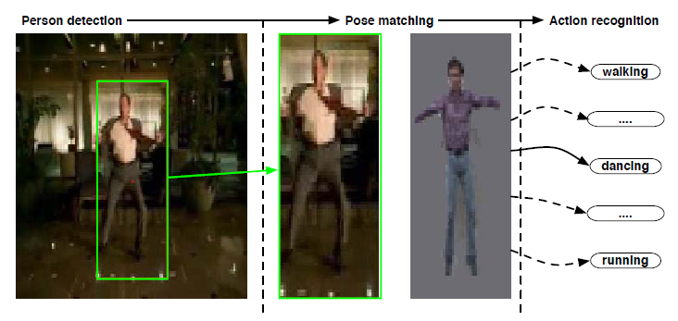
Problem
Recognize actions with 1 frame, n frame

Slide 20
Approach
Learn the bases of human pose space
Represent action sequences by histogram of pose primitives (key poses)
Classification by K-Nearest neighbor

Slide 21
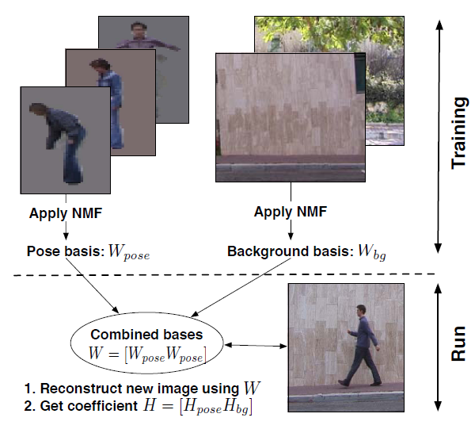
Learning representation
Using Non-negative matrix factorization (NMF)

Slide 22
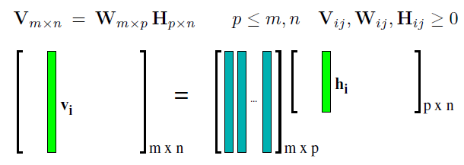
NMF to learn representation bases
Approximate a nonnegative matrix as lower rank product of nonnegative factors:
Using HOG features
Learn separate bases for human figures and backgrounds
V = [W_{pose} W_{bg}] x [H_{pose} H_{bg}]

Slide 23
Visualization of bases
For human poses
For backgrounds

Slide 24
Action recognition

Slide 25
Detecting human
Using likelihood ratio
V : data vector
V_{pose} = W_{pose} x H_{pose}
V_{bg} = W_{bg} x H_{bg}

Slide 26
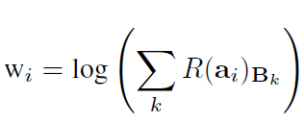
Representing actions
Histogram-based representation on pose primitives
Reweight occurrences of pose primitives
(some poses are more distinctive than others)
Exploit local context (2 consecutive frames – n-gram) ➔ implicitly model flow information

Slide 27
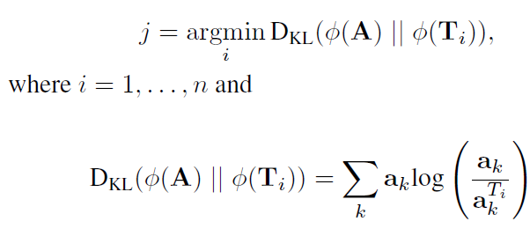
Classifying actions
K-nearest neighbors (K=1) with KL-divergence metrics
A: query action, Ti: exemplar action
Need to do smoothing here?

Slide 28
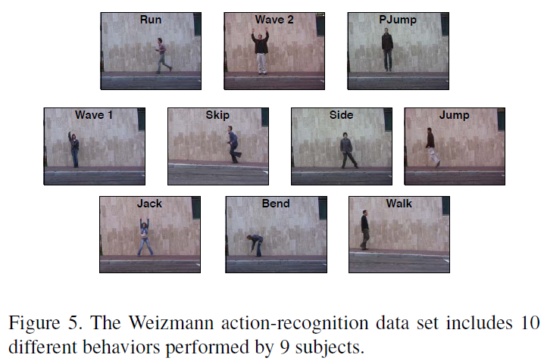
Weizmann dataset

Slide 29
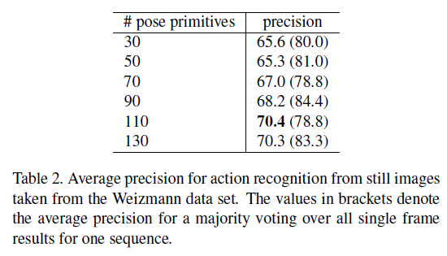
Result for still images

Slide 30
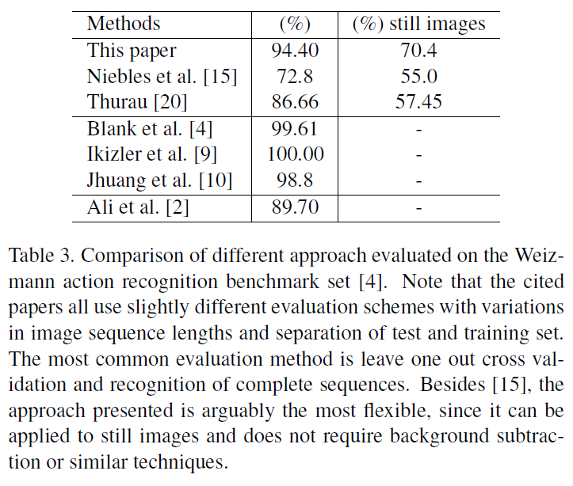
Comparison with others

Slide 31
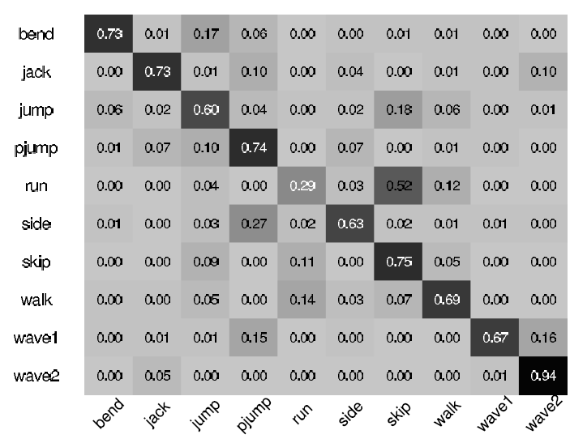
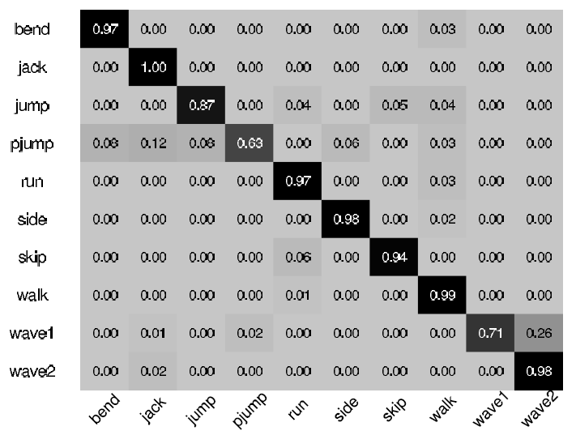
Confusion matrix
Still images
Sequences (30frames)

Slide 32
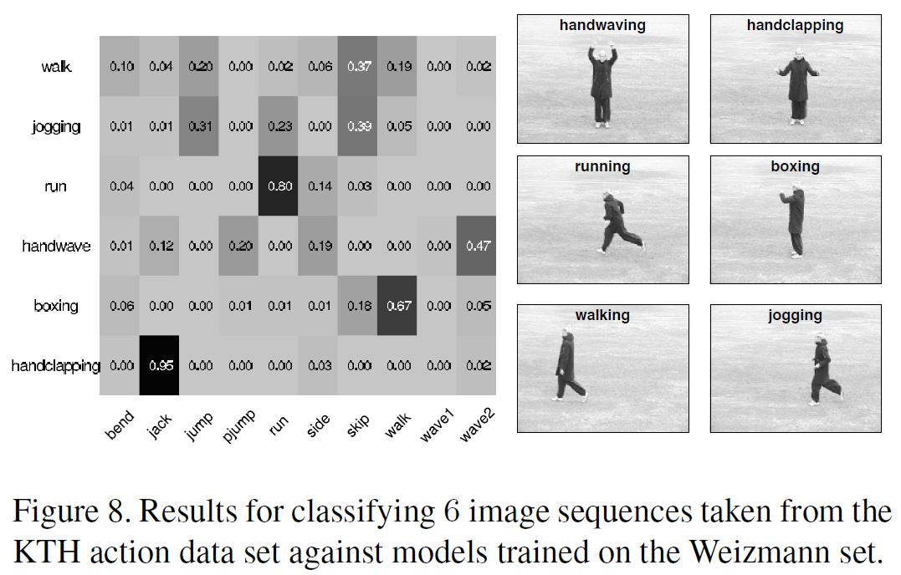
Testing on KTH dataset

Slide 33
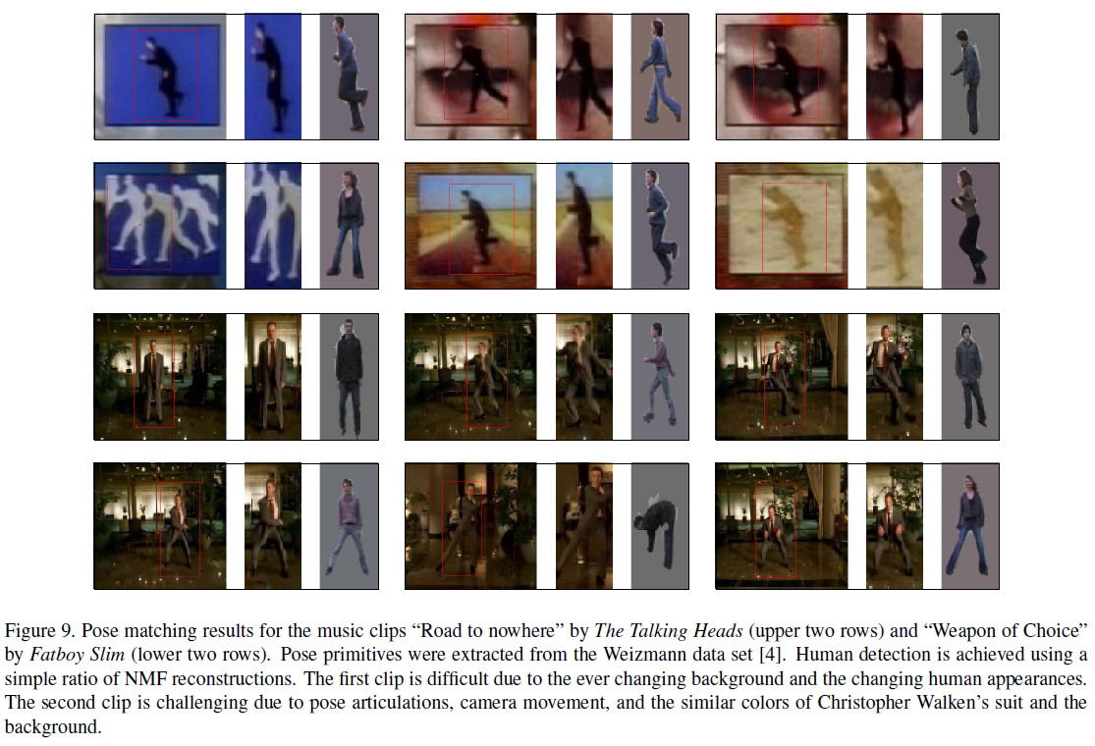
Sample pose matching on videos

Slide 34
Comments
Pros:
Give a new idea of histogram-based representation for actions
Cons:
In the real world, the number of pose primitives are huge ➔ hard for NMF method
Not clear whether NMF is better than PCA or not
Should have experiments of varying the number of frames

Slide 35
Discussions

