Slide 1
- Pictorial Structures for Object Recognition Pedro F. Felzenszwalb & Daniel P. Huttenlocher - A Discriminatively Trained, Multiscale, Deformable Part Model Pedro Felzenszwalb, David McAllester Deva Ramanan
Presenter: Duan Tran
(Part of slides are from Pedro’s)

Slide 2
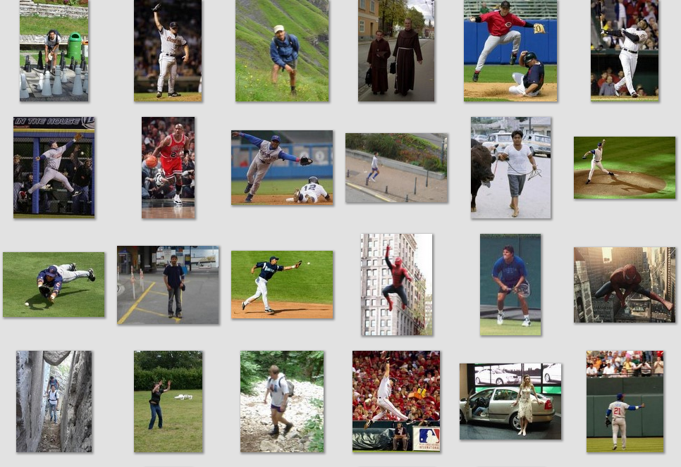
Deformable objects
Images from D. Ramanan’s dataset

Slide 3
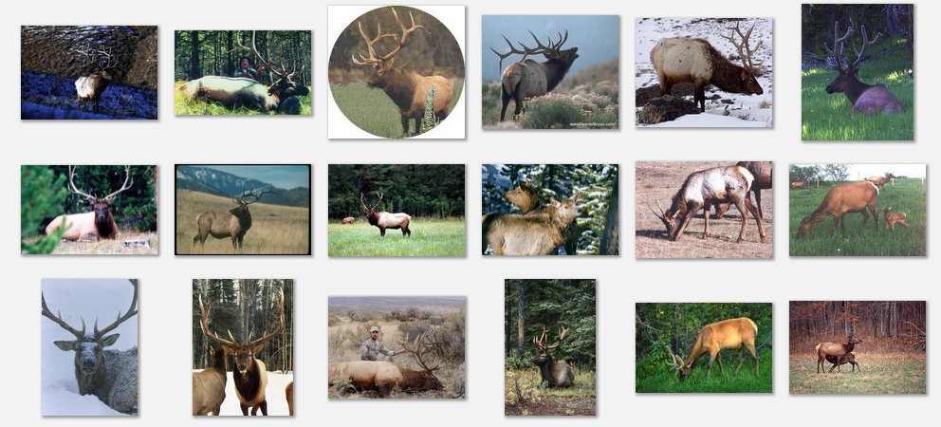
Non-rigid objects
Images from Caltech-256

Slide 4
Challenges
High intra-class variations
Deformable
Therefore…
Part-based model might be a better choice !

Slide 5
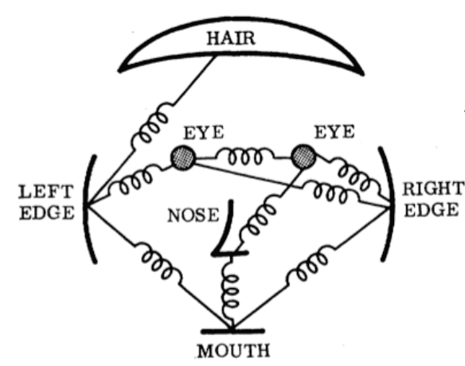
Part-based representation
Objects are decomposed into parts and spatial relations among parts
E.g. Face model by Fischler and Elschlager ‘73

Slide 6
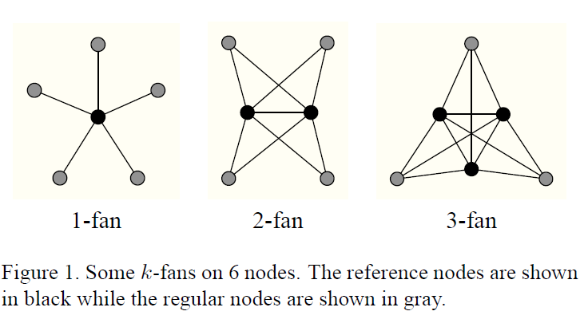
Part-based representation
K-fans model (D.Crandall, et.all, 2005)
Notes:
- Full distribution is factorized to small cliques

Slide 7
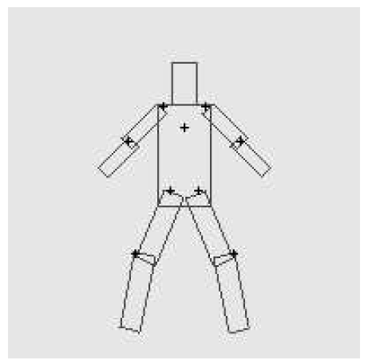
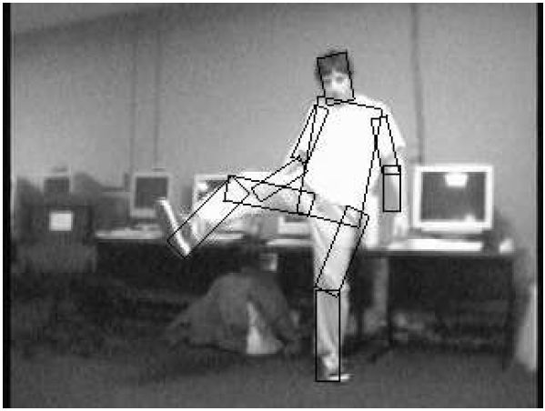
Part-based representation
Tree model ➔ Efficient inference by dynamic programming

Slide 8
Pictorial Structure
Matching = Local part evidence + Global constraint
m_{i}(l_{i}): matching cost for part I
d_{ij}(l_{i},l_{j}): deformable cost for connected pairs of parts
(v_{i},v_{j}): connection between part i and j

Slide 9
Matching on tree structure
For each l₁, find best l₂:
Remove v₂, and repeat with smaller tree, until only a single part
Complexity: O(nk²): n parts, k locations per part

Slide 10
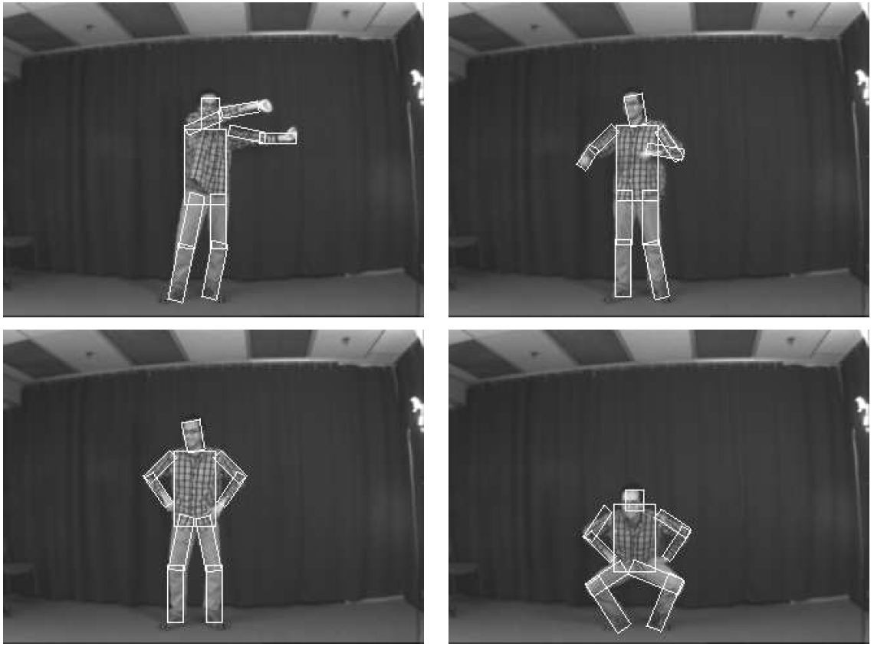
Sample result on matching human

Slide 11
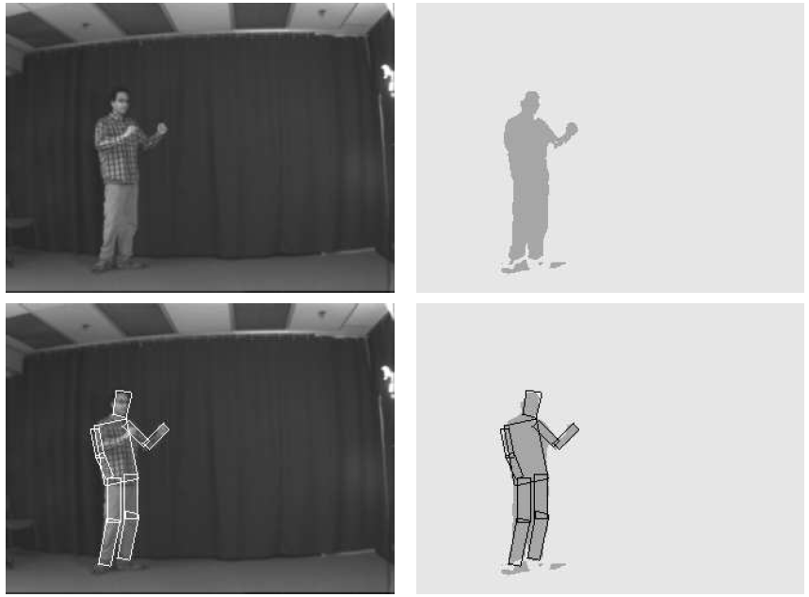
Sample result on matching human

Slide 12
A Discriminatively Trained, Multiscale, Deformable Part Model

Slide 13
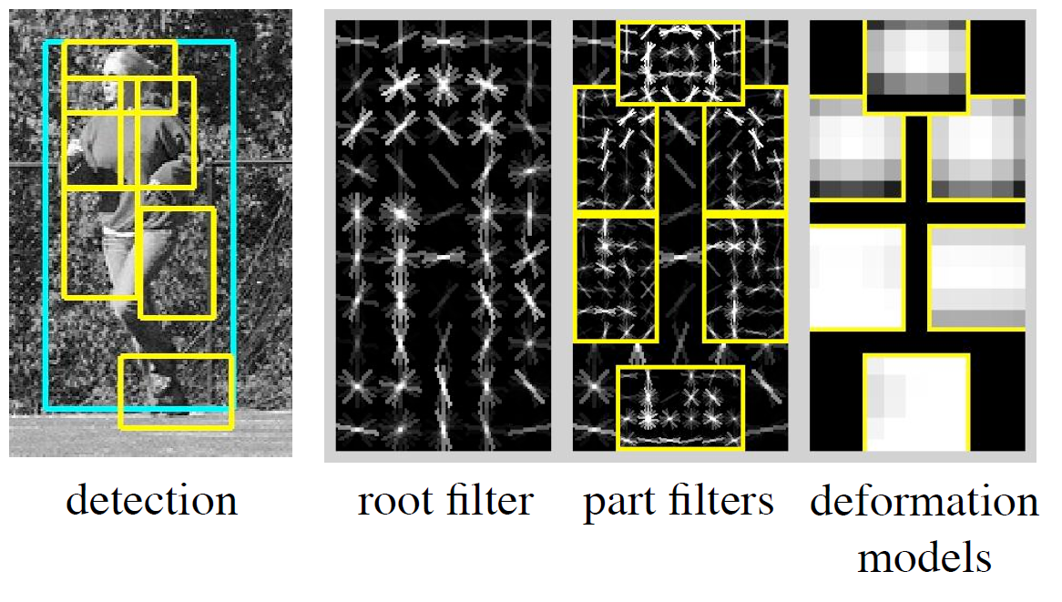
Overview

Slide 14
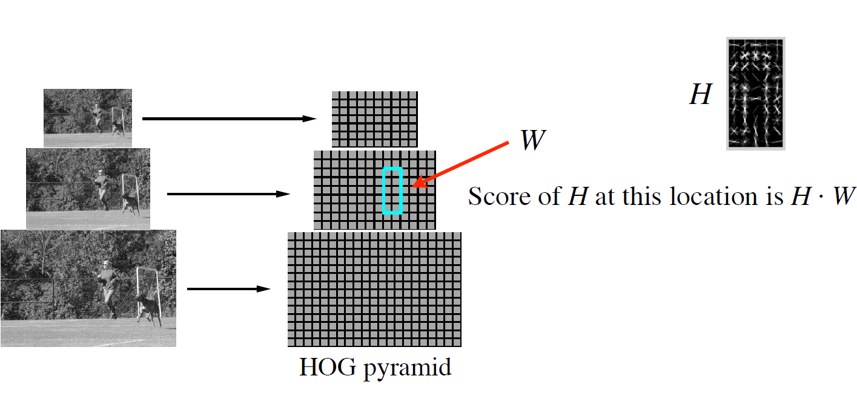
Filters
Filters are rectangular templates defining weights for features

Slide 15
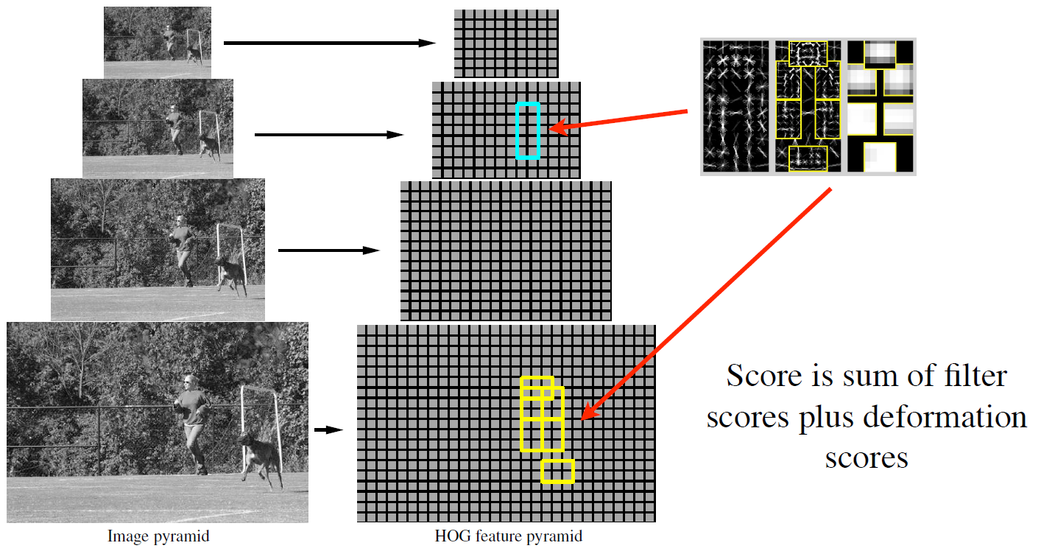
Object hypothesis
Coarser level for the root filter (whole object) and higher level for part filters

Slide 16
Deformable parts
A model consists of a root filter F₀ and part model (P₁,…,P_{n}), P_{i} = (F_{i}, v_{i}, s_{i}, a_{i}, b_{i}) Filter F_{i}; location and size of part (v_{i},s_{i}), and parameter to evaluate the placement of part (a_{i},b_{i})
Score a placement
➔ Using dynamic programming to find best placement

Slide 17
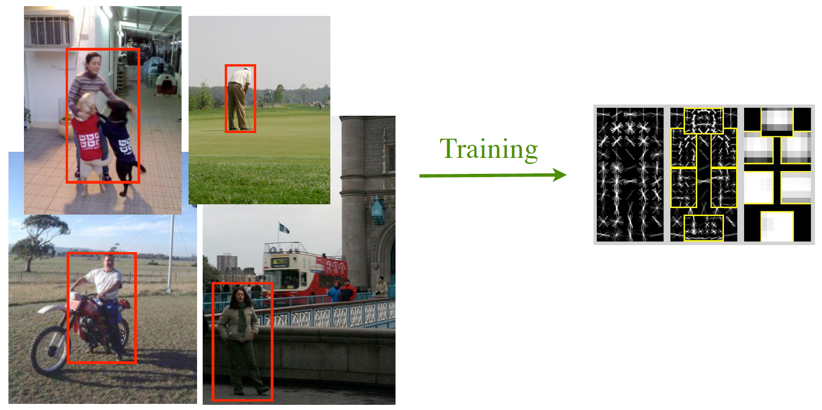
Learning
Training data consists of images with labeled bounding boxes → Learn the model structure, filters and deformation costs

Slide 18
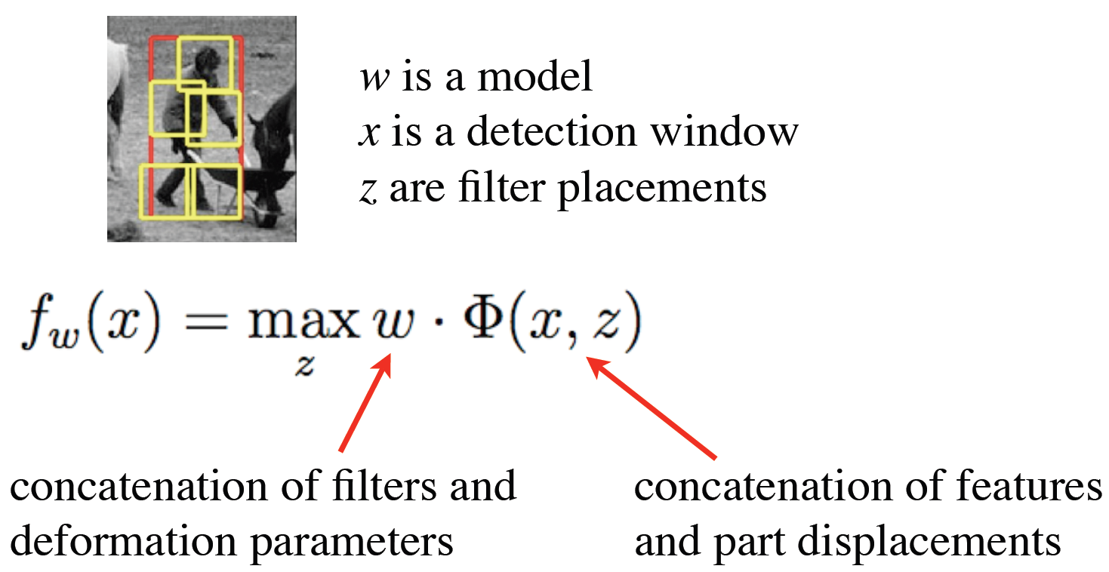
SVM-like model
(Latent Variables)

Slide 19
Latent SVM
Linear SVM (convex) when z is fixed
Solving by coordinate descent
Fixed w, find the latent variable z for the positive examples
Fixed z, solve the Linear SVM to find w

Slide 20
Implementation details
Select root filter window size
Initialize root filter by training model without latent variables on unoccluded examples.
Root filter update: get new positives (best score and significant overlap with ground truth), add to positives and retrain
Part initialization: sequentially choosing area a having high positive score and 6a = 80% root area

Slide 21
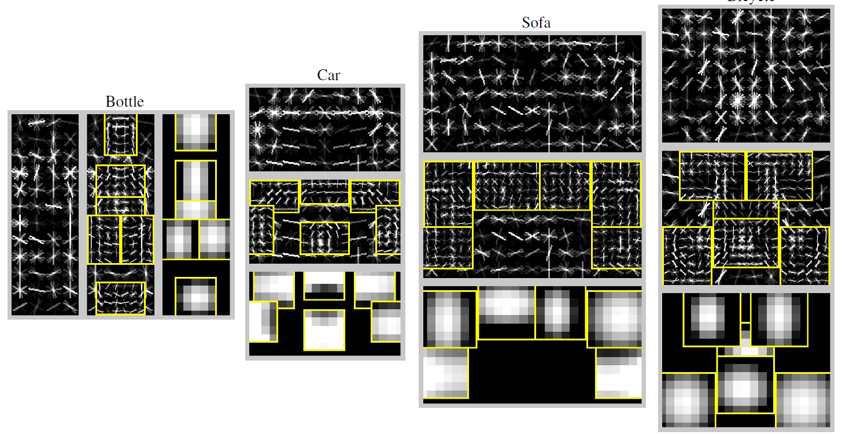
Learned models

Slide 22
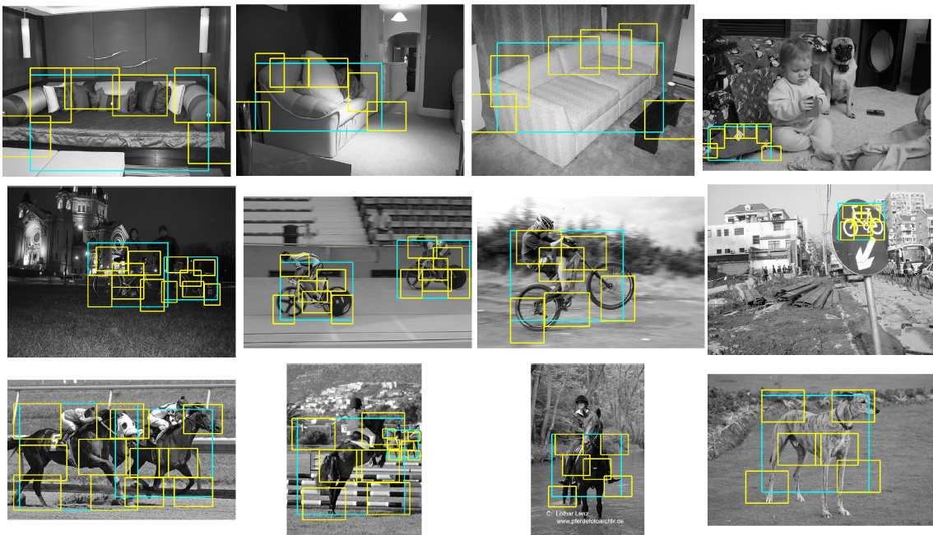
Sample results

Slide 23
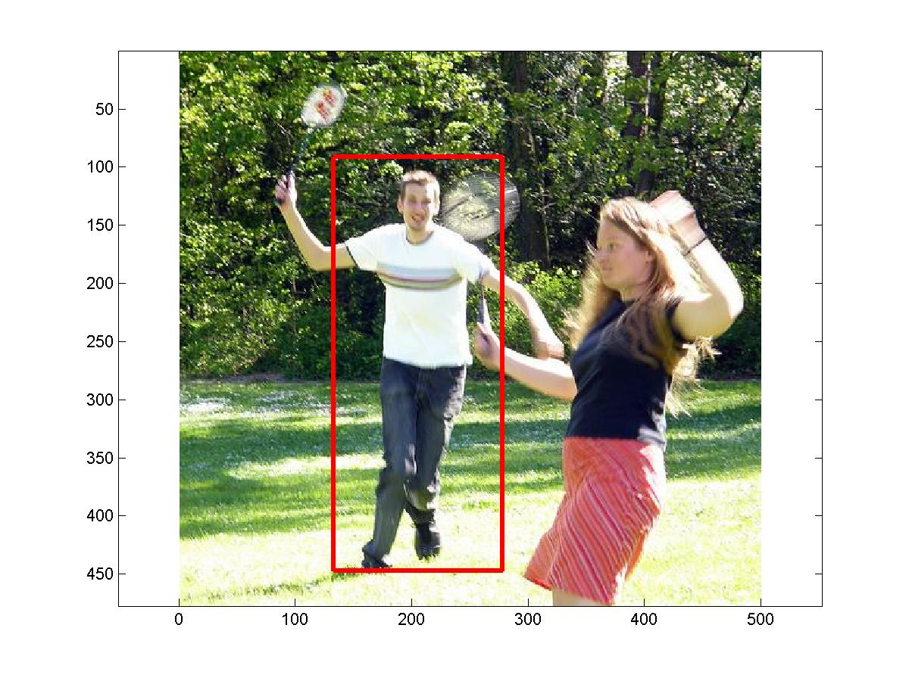
Other results

Slide 24
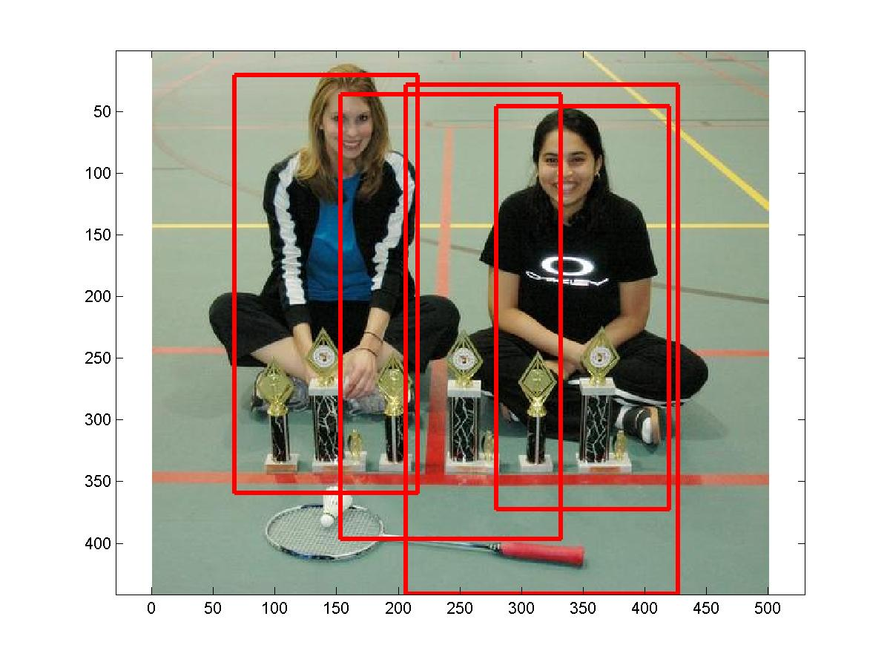
Other results

Slide 25
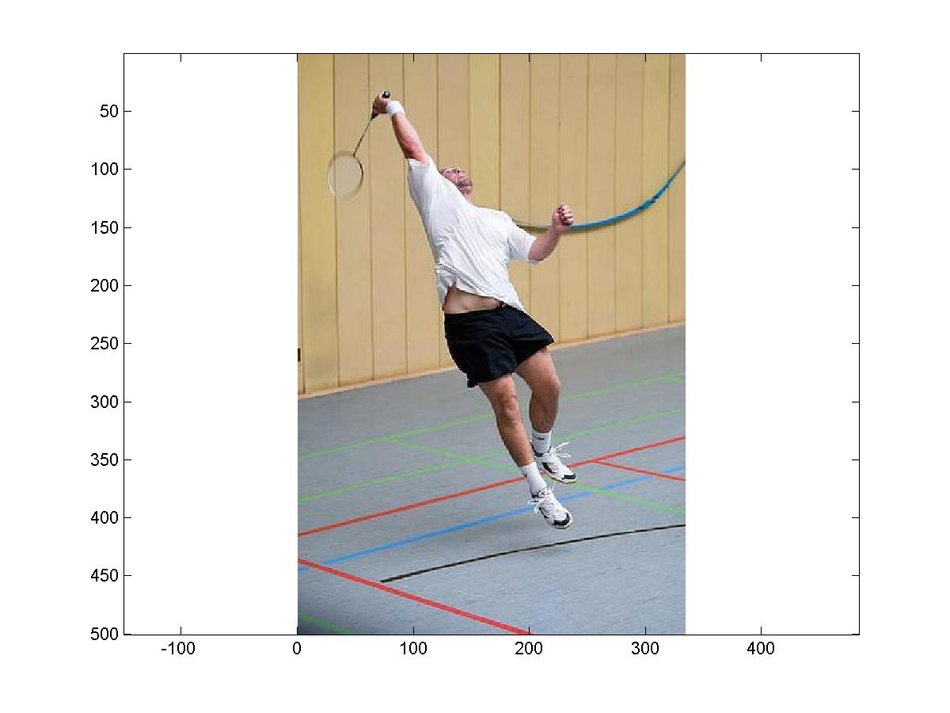
Other results

Slide 26
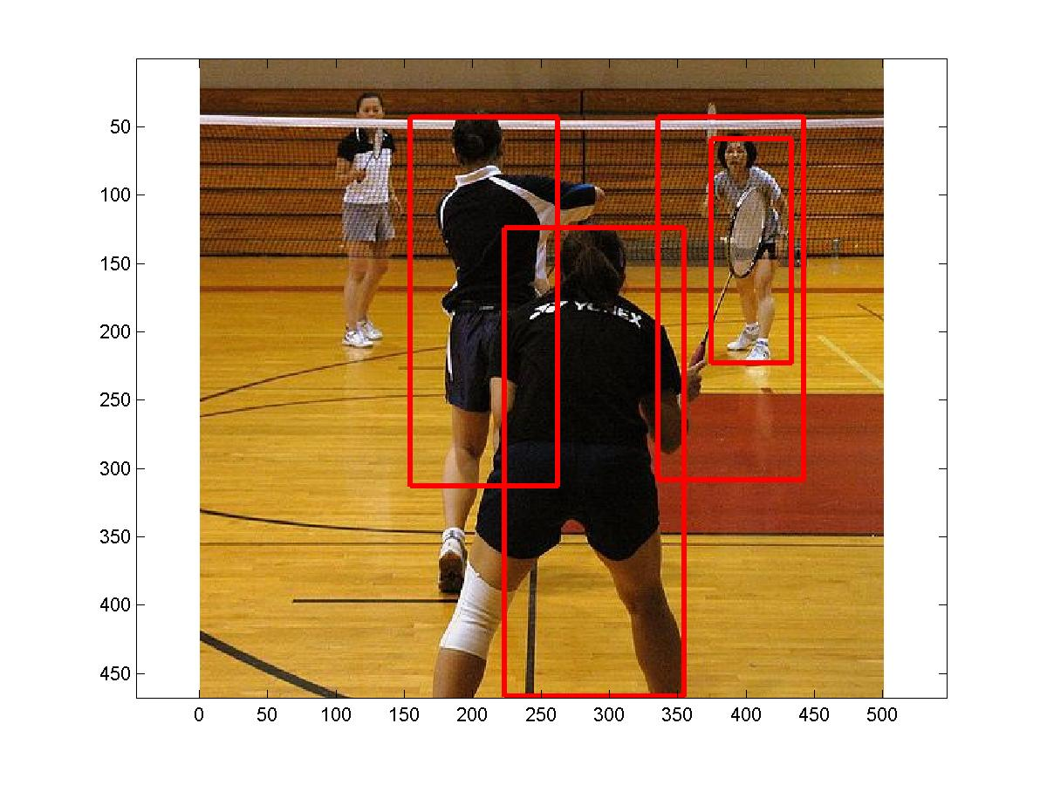
Other results

Slide 27
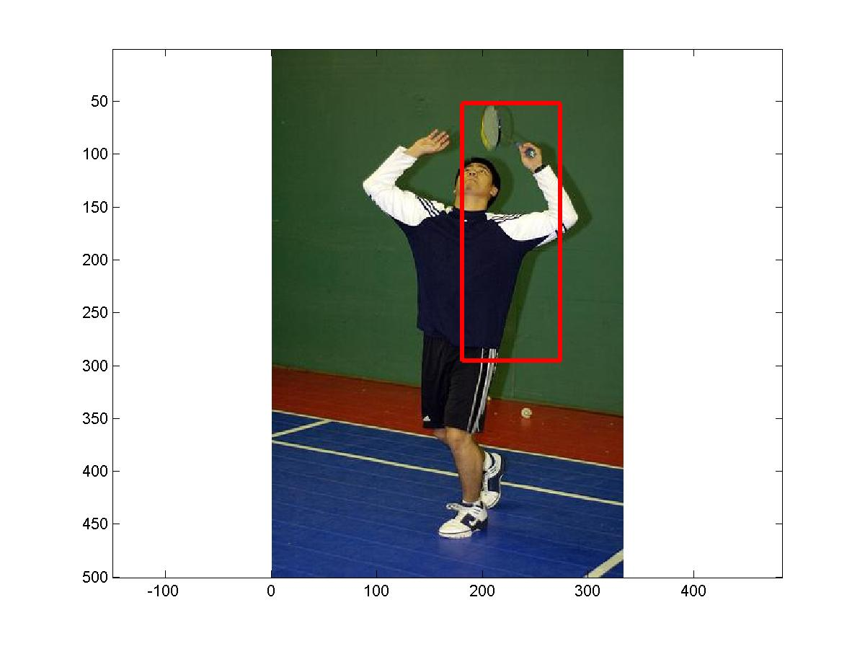
Other results

Slide 28
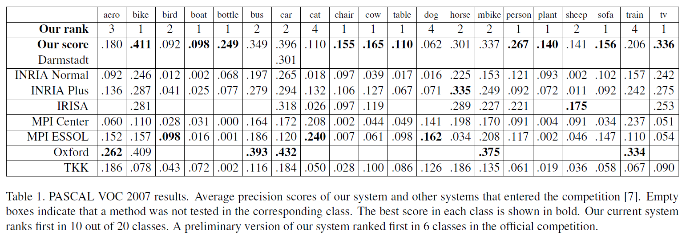
Pascal VOC Challenge tasks

Slide 29
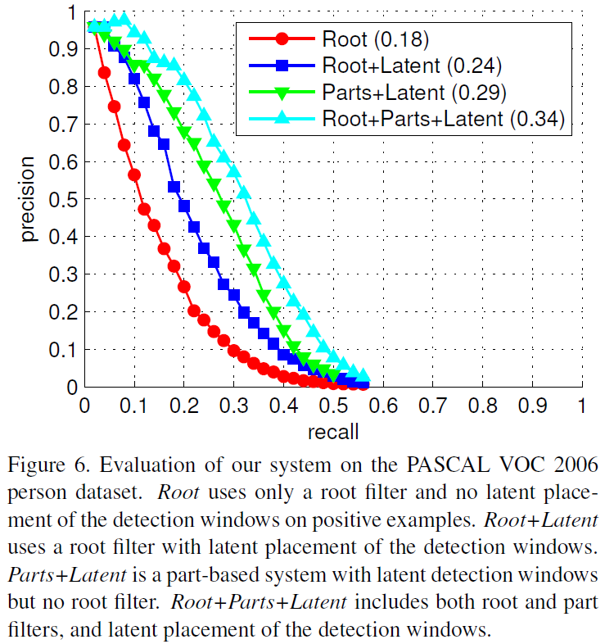
Pascal2006 Person

Slide 30
Discussion
Mani: Couple of questions: How parts could be defined in various objects? When does breaking objects or parts into parts help in doing a better job?
Gang: The successful object representation turns out to be a global object template + several parts templates. There are two questions: (1) How to deal with occlusion? Occlusion seems to be the biggest difficulty for PASCAL object detection. And such a global structure (though it has parts, but all the parts are constrained by a global spatial relationship) cannot deal with occlusion. (2) What makes a part? Is there a part? For the first question, extracting information from multiple levels might be helpful. Except the global spatial structure, we also extract such structure at different scales and train separate classifiers. The final detection output is the fusion of all these classifiers with learned weights.

Slide 31
Discussion
Mert: Considering the success of the sliding window + classifier approach, there are couple of natural questions one would ask: 1) Will using different kinds of features help? 2) Can you do a better job on deformable objects by breaking them into respective parts? According to earlier papers in the literature the answer to both questions is yes. Felzenszwalb et al.'s results convincingly demonstrate the affirmative conclusion for the second question. The big question to be answered is however, how far we can push the sliding window approach and whether we can obtain the ultimate object detector through this paradigm.
Sanketh: I concur with Mert's comments on how far we can push object detection with the sliding window approach. Ultimately, I believe there is just too much variability in part placement and part shapes for gradient histogram based techniques to be effective. It is interesting that most of the popular object recognition paradigms completely ignore segmentation as a possible source of information for object recognition. A combination of segmentation + orientation histograms may be something worth trying. I am unclear on a few details in the Latent-SVM training. Especially on how it goes from being non-convex/semi-convex to convex. It will be helpful if we could go into some details of the process there. It seemed that the model described in the initial part of the paper was not implemented in its entirety.

Slide 32
Discussion
Ian: One very appealing extension of this machinery is to enforce that each "part" has some underlying semantics. It is not clear if such a constraint would decrease performance, since the existing parts are chosen for their high discriminative ability. However, one may argue that without this extra prior knowledge, it may be difficult to learn that a part like articulated arms occurs in many images of people, but this part is still a strong cue for recognition.
Eamon: At what stage does searching for an object make more sense than searching for its parts? In some sense, even an entire scene could be considered a deformable object with its constituent objects acting as parts constrained to certain (contextually-dependent) locations.

